Slide 1
License Attribution / Use
This work is licensed under a [Creative Commons Attribution 4.0 International License][cc-by].
Use or Adaption of this work requires attribution to the FinOps Foundation under the ccby4.0 license.
You are free to:
Share — copy and redistribute the material in any medium or format
Adapt — remix, transform, and build upon the material for any purpose, even commercially.
Under the following terms:
Attribution — You must give appropriate credit, provide a link to the license, and indicate if changes were made.
More details can be found at https://www.finops.org/introduction/how-to-use/

Slide 2
Advancing the people who manage the value of cloud
FinOps.org

Slide 3
Cloud is critical to every business but is a fundamentally different consumption model...
Decentralized
Variable
Scalable
Engineers siloed from Finance (and Procurement) are empowered to commit the company to spend
Variable cloud spend replacing data center/fixed cost spend
Instant access to resources enables innovation but often results in overprovisioning
Notes:
Cloud is critical to success by bringing The new cloud economy has us facing some new realities in the IT world:
Traditional procurement silos have broken down, buying is decentralized, and it’s only getting more so
Cloud adoption, once the purview of CTOs and the location of science-fair projects now represents MATERIAL and substantial costs for many companies, and it’s only growing
What you buy in the cloud is variable, it changes month to month, day to day, minute to minute. It’s not predictable, and it’s hard to forecast well using traditional methods. And with over 1M Cloud SKUs out there, it’s only getting more complex.
In a cloud world of vast supply, plentiful options and few constraints on your spending, inefficiency is inevitable. But all businesses must focus on efficiency, and need the information to create it. Further, macroeconomic pressures – elections, Brexit, and the coming economic downturn (eventually there will be one) – require even more ruthless efficiency measures.
Inefficiency becomes a target on IT’s back (very important) in a downturn.
Luckily, there’s also a new operating model for the cloud to help address these realities.

Slide 4
Cloud FinOps is an evolving cloud financial management discipline and cultural practice that:
FinOps.org
enables organizations to get maximum business value
FinOps is not shorthand for “Financial Operations”. It is a portmanteau of “Finance” and “(Dev)Ops” stressing the communications and collaboration business and engineering teams.
by helping engineering, finance and business teams
to collaborate on data-driven spending decisions
Use of this work requires attribution to the FinOps Foundation under the ccby4.0 license

Slide 5
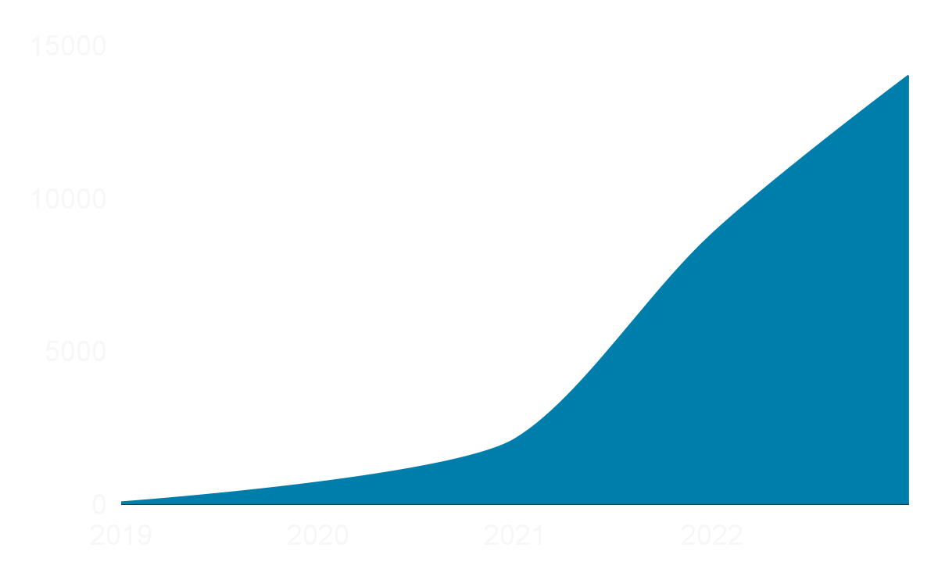
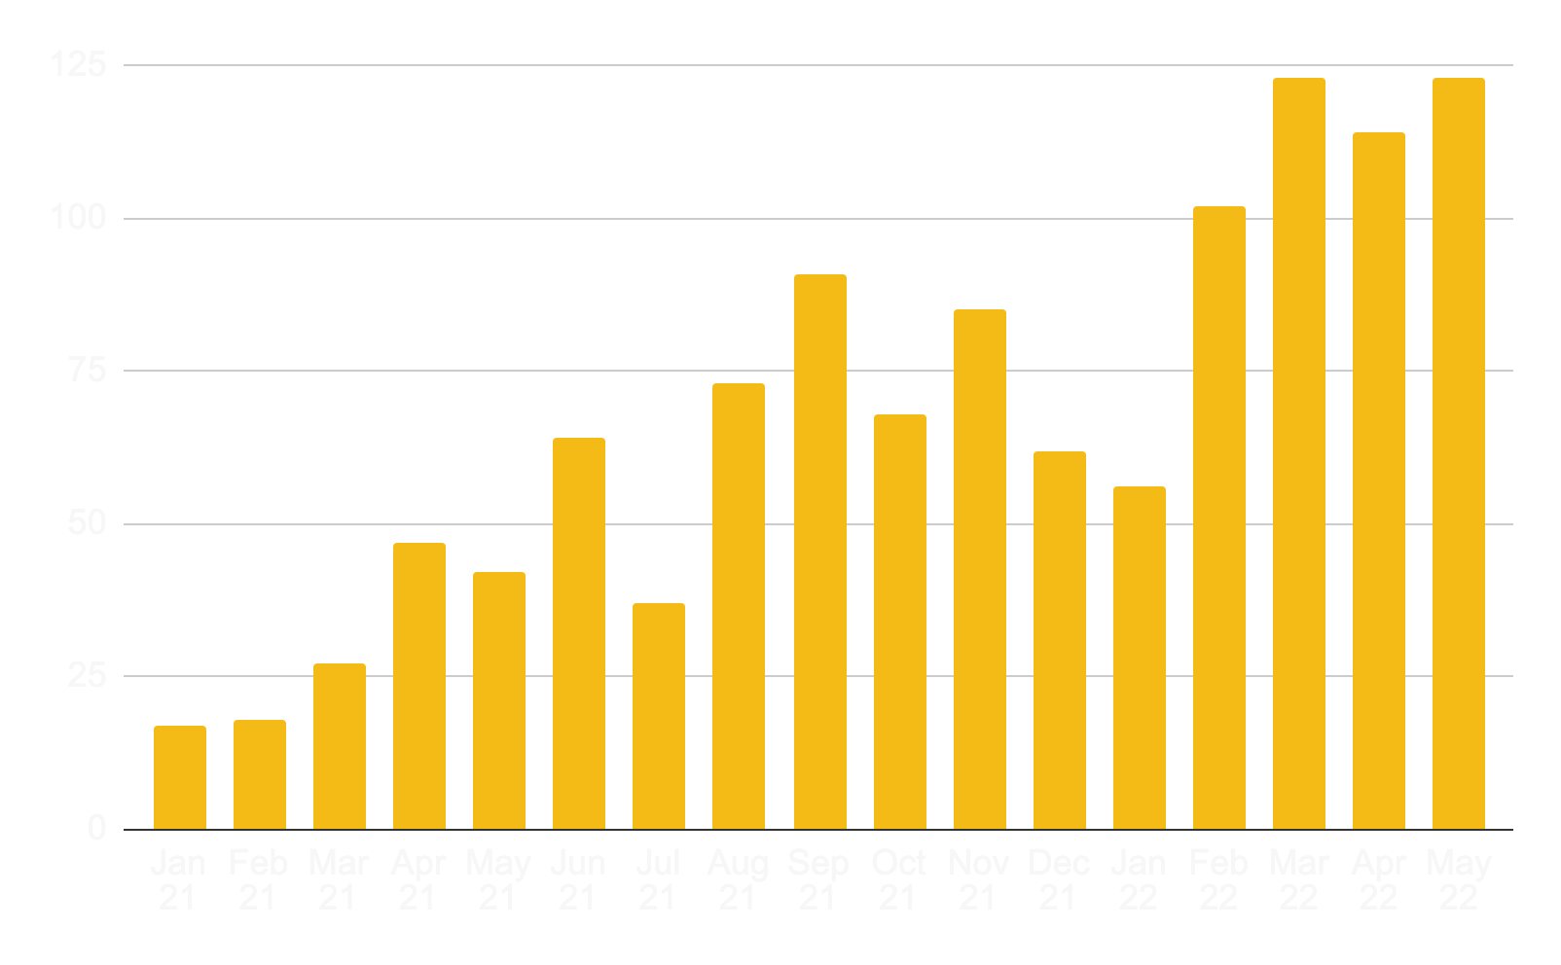
The FinOps industry has hit an inflection point this year…
(we just launched jobs.finops.org too)
Social proof of those offering or seeking skills
Linkedin (People - FinOps)
Posts in #jobs in the Slack 2021-2022
8000+ Community Members

Slide 6
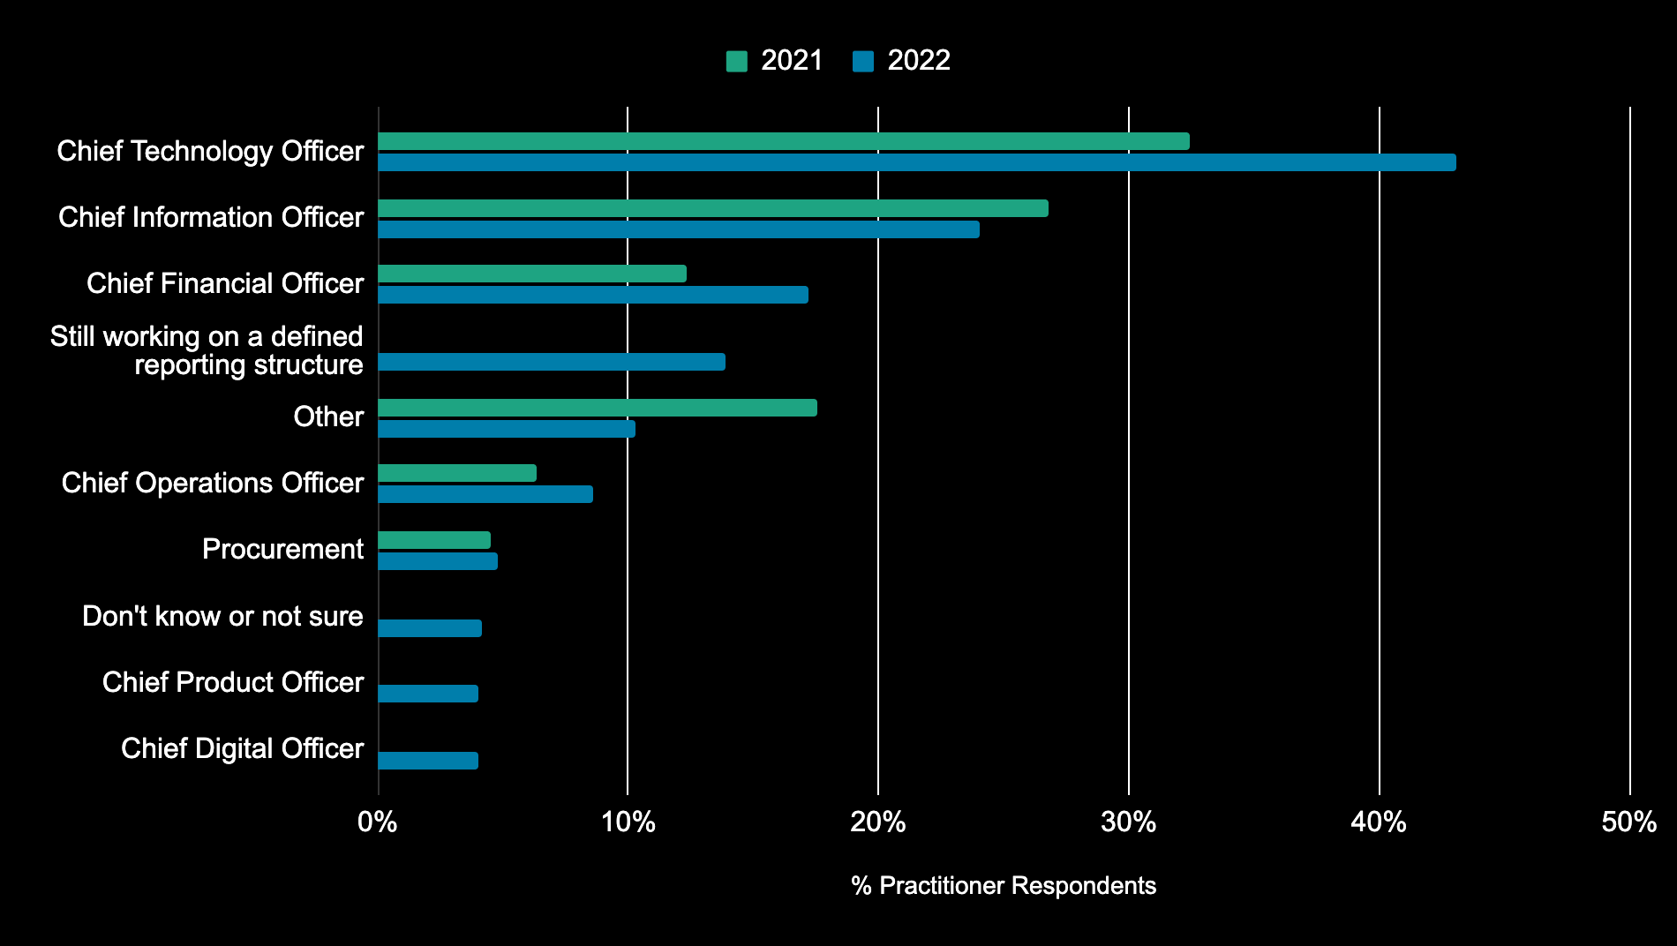
Where does FinOps/cloud financial management report in your organization? (multi-select question; answers total more than 100%)
Use of this work requires attribution to the FinOps Foundation under the ccby4.0 license

Slide 7
Team sizes scale as maturity develops
Crawl
Walk
Run
3 Current team size
5 Current team size
9 Current team size
6
12-months from now
8
12-months from now
14
12-months from now
Use of this work requires attribution to the FinOps Foundation under the ccby4.0 license
2021 avg team size 7
Notes:
Kim - in crawl phase but went big, 15-20 people. Depends on company approach: build vs buy approach for talent. Fluctuating regularly.

Slide 8
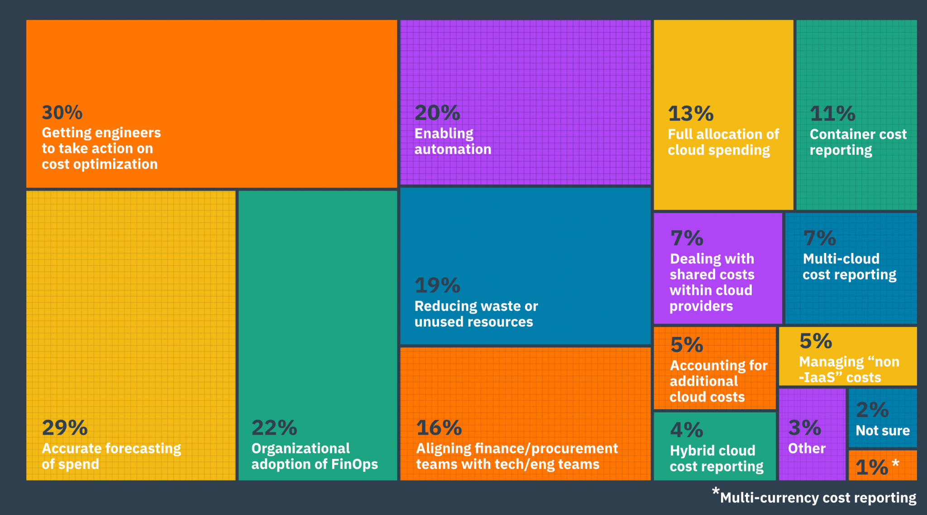
Data.FinOps.Org: what are your top challenges?
Use of this work requires attribution to the FinOps Foundation under the ccby4.0 license
Notes:
Getting engineers to take action on cost optimization” is the clear winner here-- it’s a challenge all FinOps teams seem to face. Other big challenges include allocating shared and unallocated costs, forecasting variable spend, aligning tech and finance teams, reporting on container costs, and reducing waste.

Slide 9
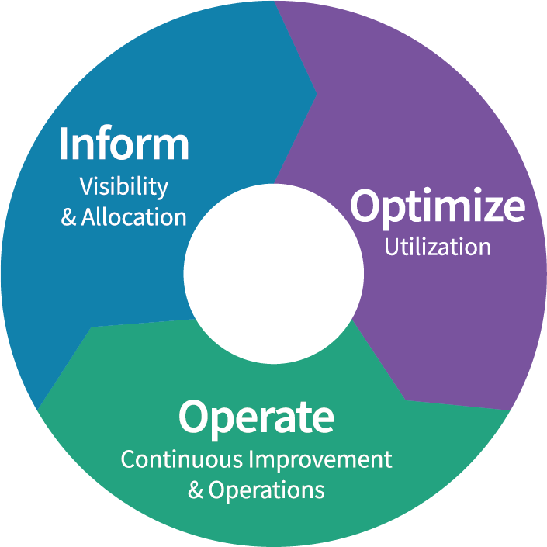
FinOps
Framework
Use of this work requires attribution to the FinOps Foundation under the cc by 4.0 license
FinOps is an evolving cloud financial management discipline and cultural practice that enables organizations to get maximum business value by helping engineering, finance & business teams to collaborate on data-driven spending decision
Maturity
Crawl
Walk
Run
Principles
Personas
Phases
Teams need to collaborate
Everyone takes ownership for their cloud usage
A centralized team drives FinOps
Reports should be accessible and timely
Decisions are driven by business value of cloud
Take advantage of the variable cost model of the cloud
FinOps Practitioner
Executive
Rates
& Usage
Business/Product Owner
Finance/Procurement
Engineering/Operations
Domains
Understanding Cloud Usage and Cost
Performance Tracking & Benchmarking
Real-Time Decision Making
Cloud Rate Optimization
Cloud Usage Optimization
Organizational Alignment
Notes:
The FinOps Framework describes the
Principles that drive our FinOps practices
The Personas that FinOps must support as stakeholders
The best practices and process models that allow us to accomplish this
And the Domains of activity we will have to perform in our FinOps practice
You May have heard the Framework called the FinOps Capability Model, or the FinOps Function model previously.
Updated beginning in Fall 2021, will continue to be modified as time goes on, but is largely stable as of January 2022.
FinOps practitioners will perform activities in each of these domains as they build a FinOps team and drive the cultural change that FinOps brings into their organizations.
There are Capabilities within each Domain that describe the detailed activities that a

Slide 10
FinOps Foundation Mission
To advance every individual who manages the value of cloud wherever they are.
Create Connections
Inspire
Growth
Empower Best Practices
Objective: Enriching connections wherever you are
Objective: Advancement for whatever level you are
Objective: The definitive resource for all FinOps practices

Slide 11
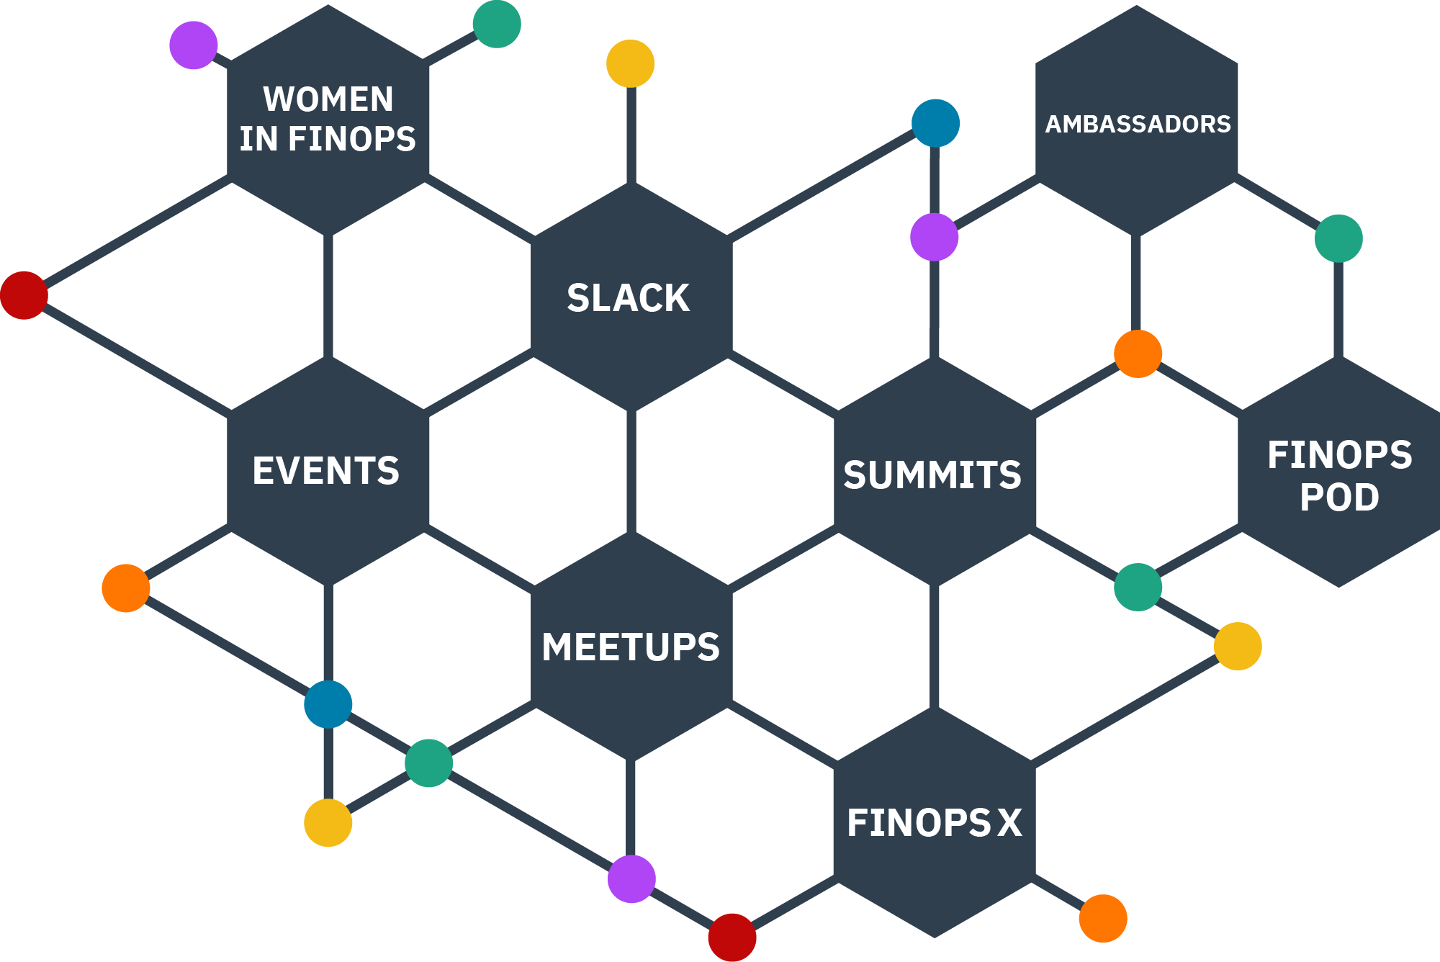
FinOps Community
Join our community of members to enrich your connections and
knowledge through events, meetups, virtual summits, working group contributions, Slack discussions and other activities.

Slide 12
Addendum

Slide 13
8200
2500
PREMIER ENTERPRISE PARTNERS
IN THE COMMUNITY
CERTIFIED PRACTITIONERS
www.finops.org/membership
Notes:
ASHLEY
We launched our new Enterprise Partnership at the beginning of 2022. These Enterprises are investing in the community by contributing best practices and artifacts, hiring practitioners, helping shape training, and being strong practitioner voices on the GB – helping us drive foundation strategy, etc.
Our first enterprise partner, Apple has been engaged in the forecasting working group, which you will hear from later and we are excited to have HERE technology join under Jason Fuller's leadership.
Staff to share: https://www.finops.org/membership/enterprise/
Mention Apple & HERE

Slide 14
8200
2500
PREMIER PARTNERS
IN THE COMMUNITY
CERTIFIED PRACTITIONERS
Notes:
ASHLEY

Slide 15
8200
3000
GENERAL PARTNERS
IN THE COMMUNITY
CERTIFIED PRACTITIONERS
Notes:
J.R.

Slide 16
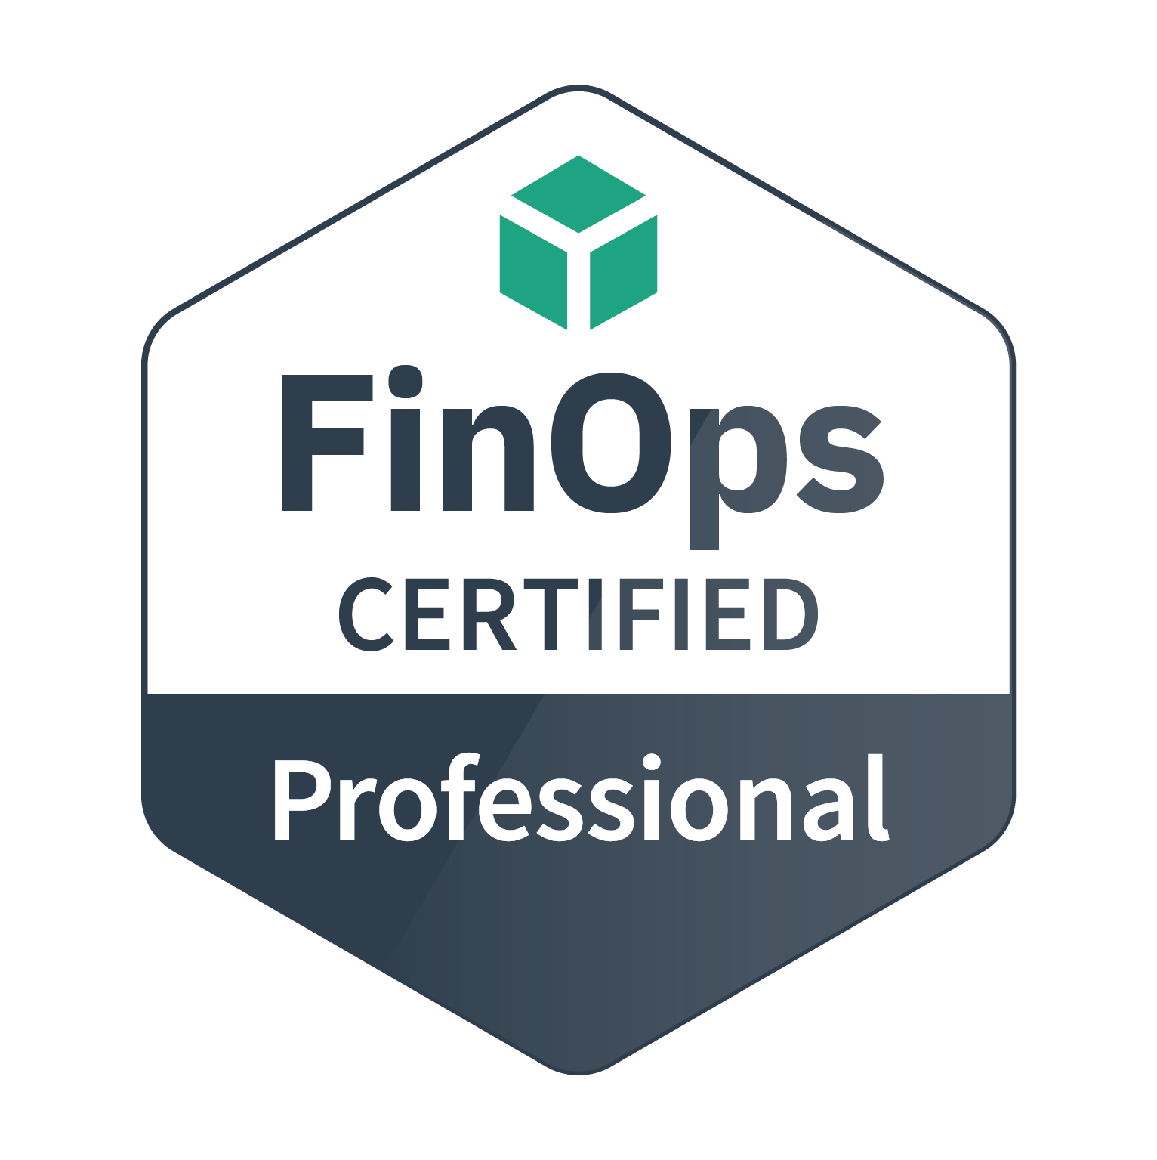
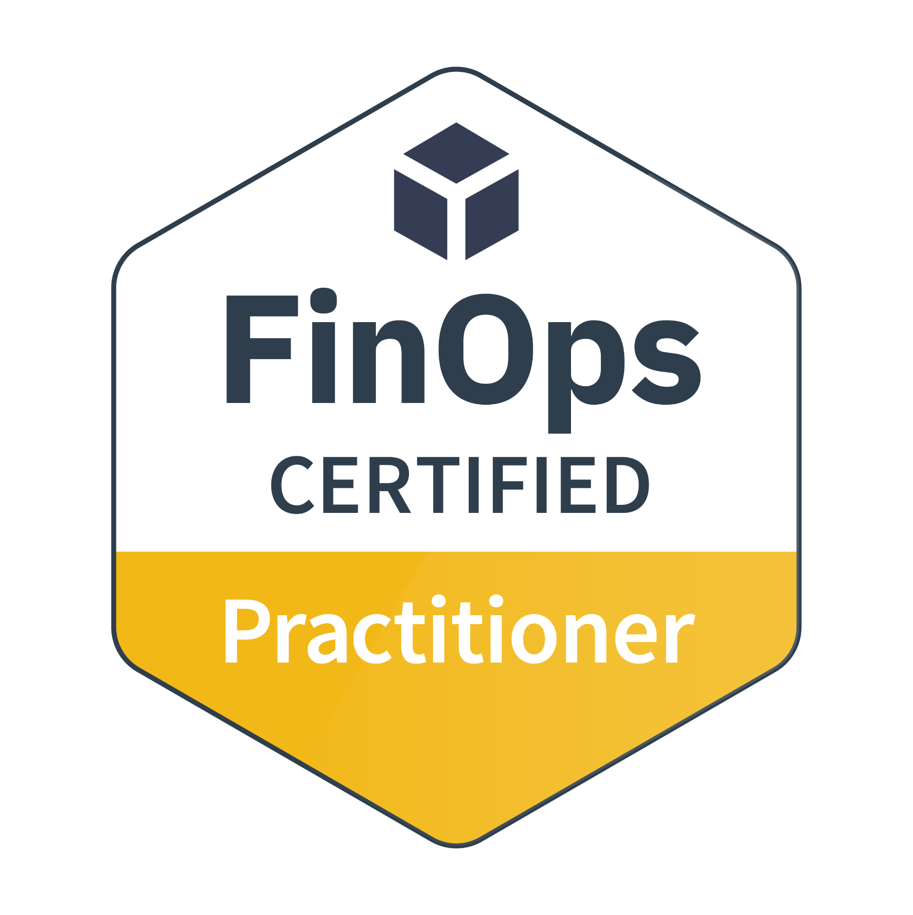
Training and Certification
Certification Track for FinOps practitioners and consultants
FinOps Certified Practitioner
FinOps Certified Professional
Persona-based Training for stakeholders working with FinOps teams
Individual courses for Engineers, Finance, Executives, Procurement and Product
Go to FinOps.org/certification
77% share on LinkedIn* *Source: October 2021 Credly.com Badge Share Data
Notes:
Our funding comes from two primary sources: 1) is Training/Certification.
There’s the FOCP now and also FOFE. FOFA is in development as well as persona based trainings for Finance/Execs/etc.

Slide 17
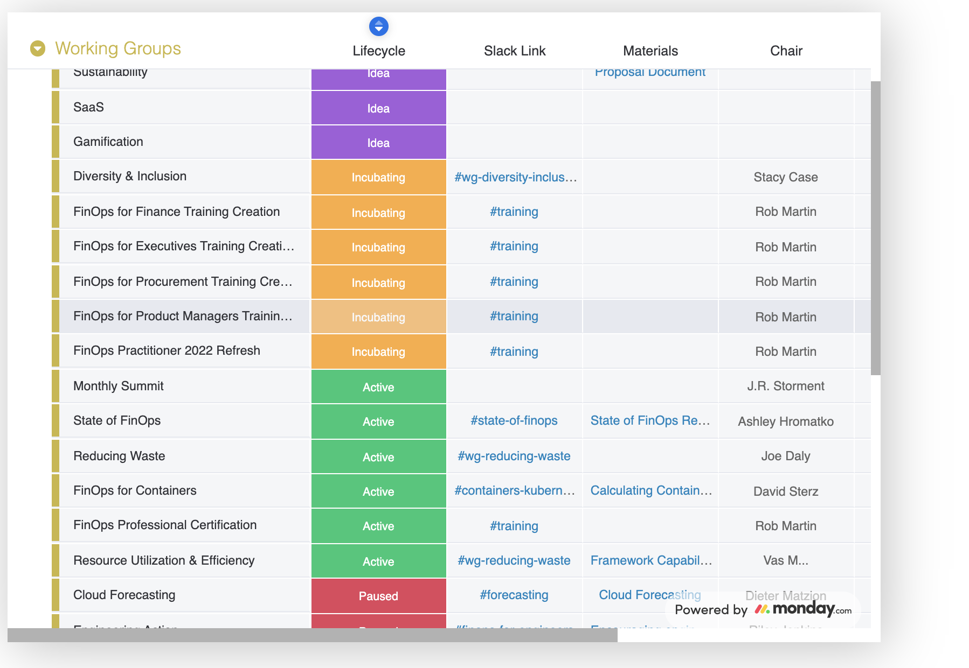
Contribute to Working Groups
Practitioner Working Groups (WG) create best practices and standards, supported by vendor members.
Special Interest Groups (SIG) create community and benchmarking.
These feed into the FinOps Framework and output Projects.
See Current Groups

Slide 18
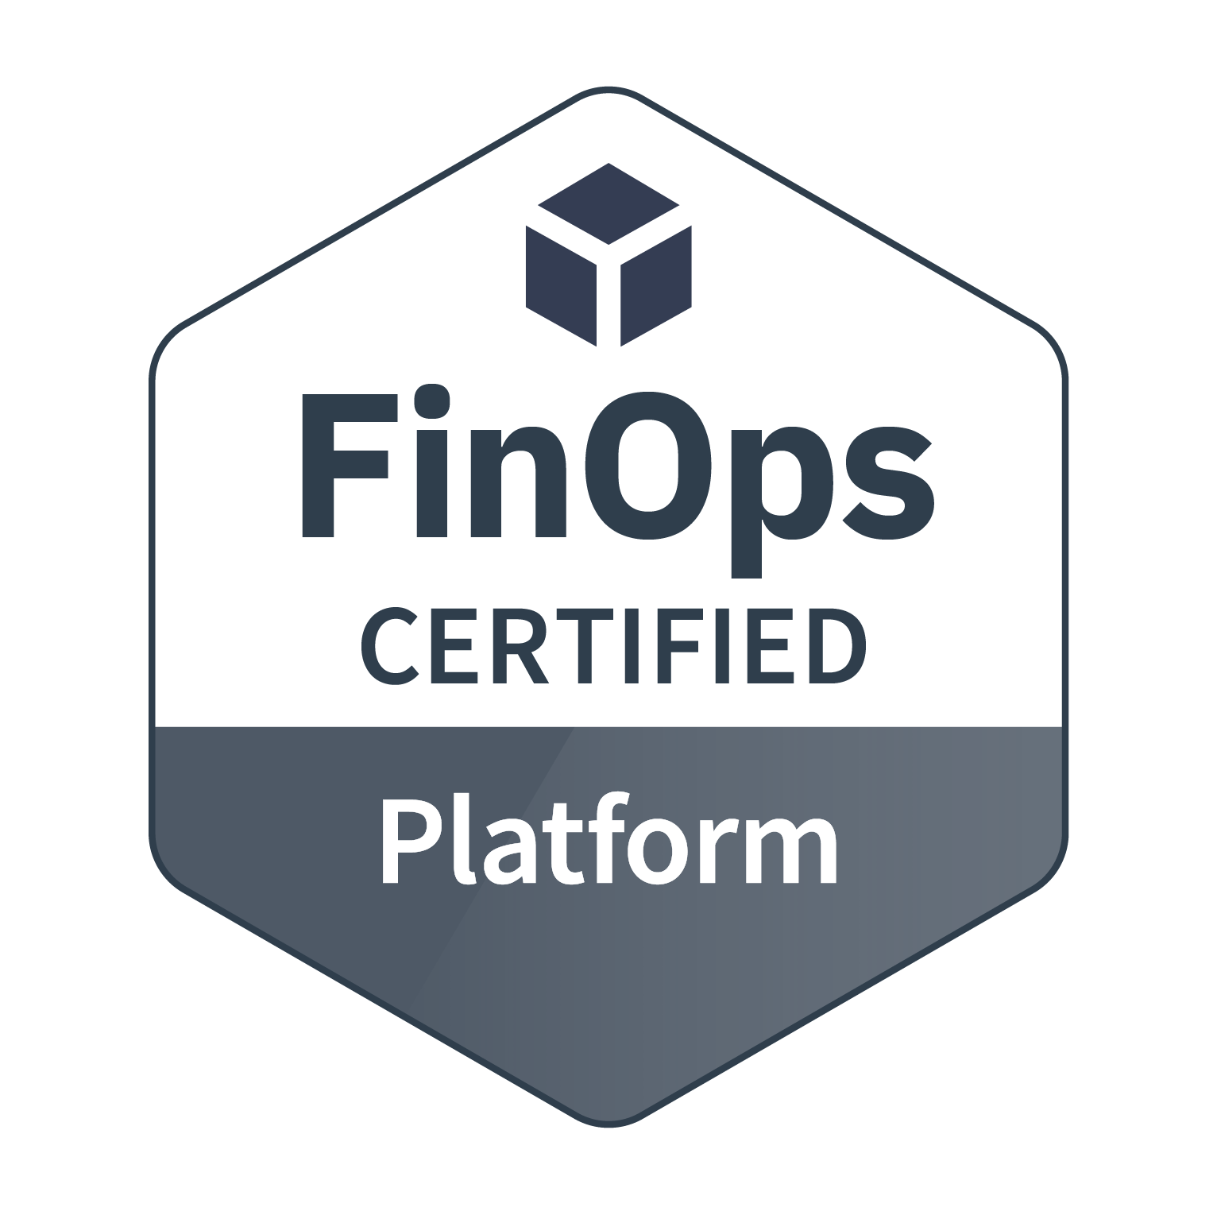
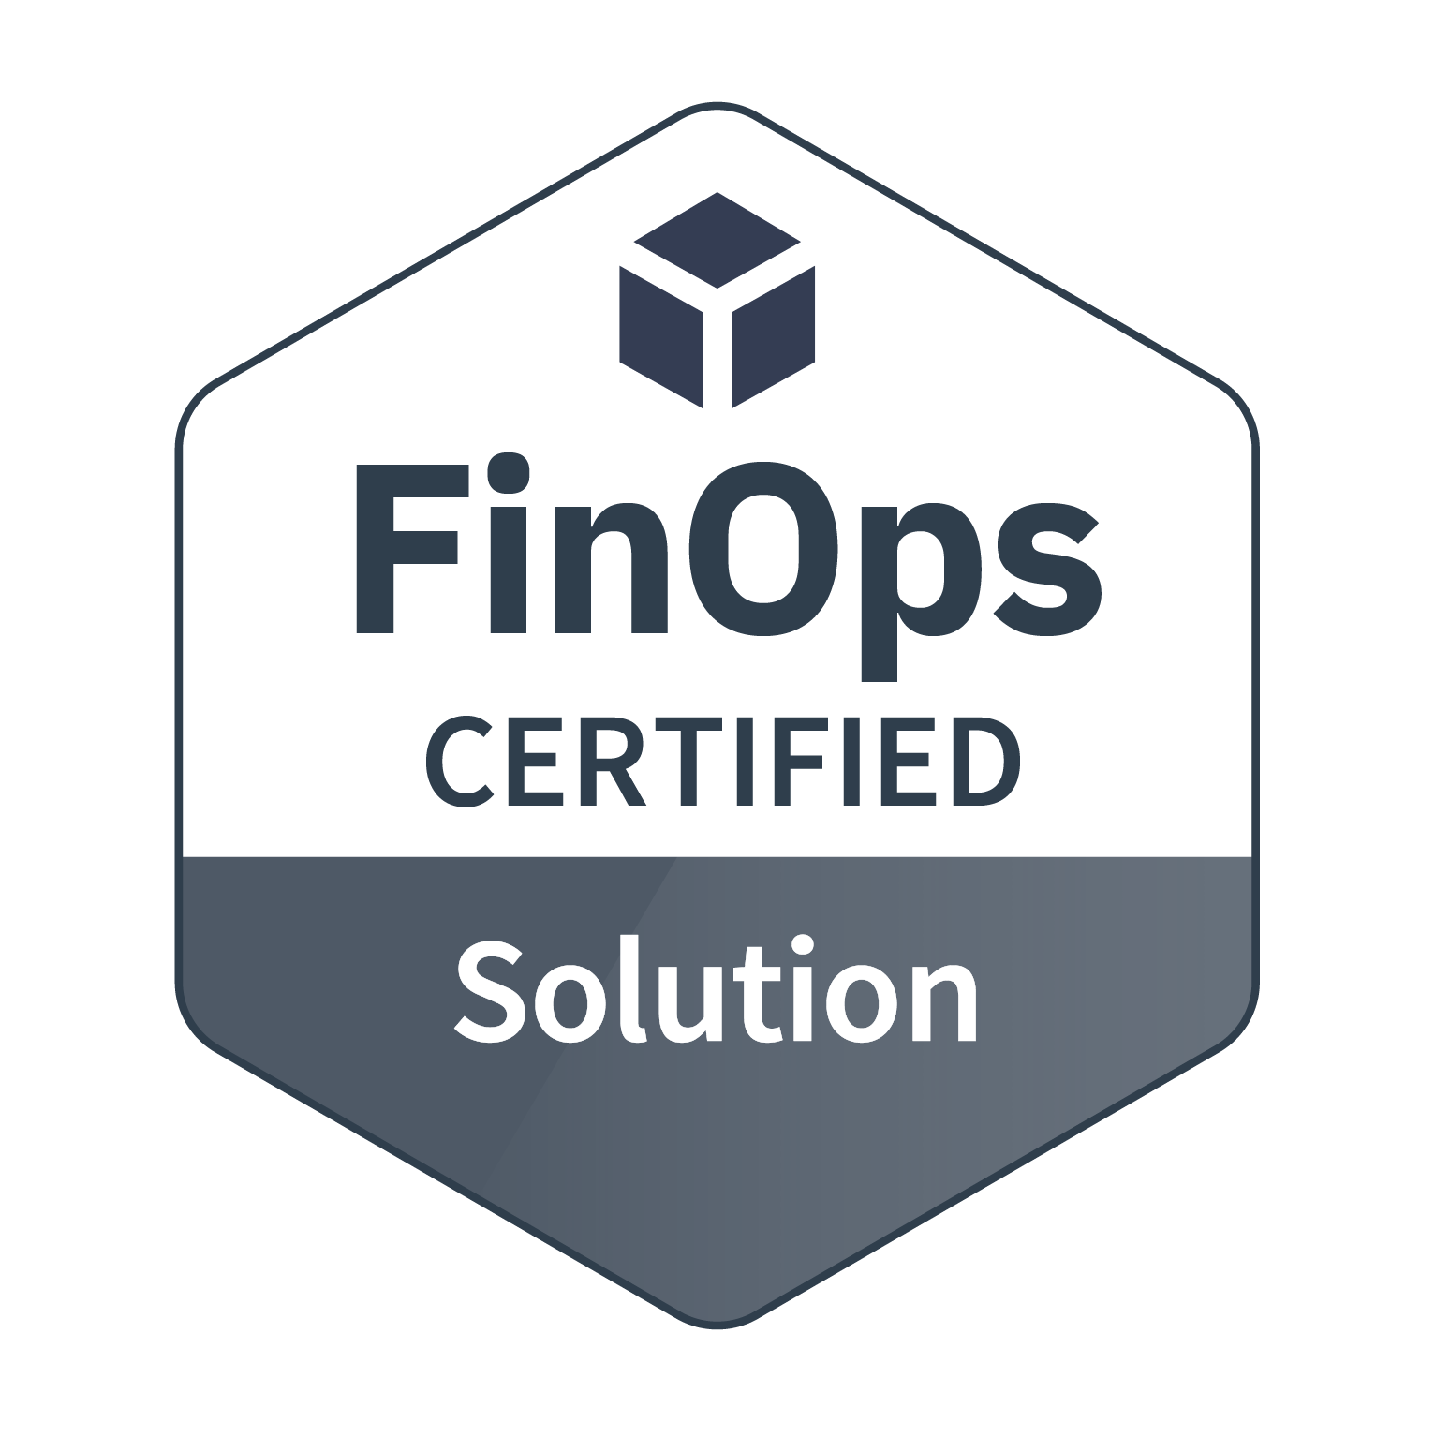
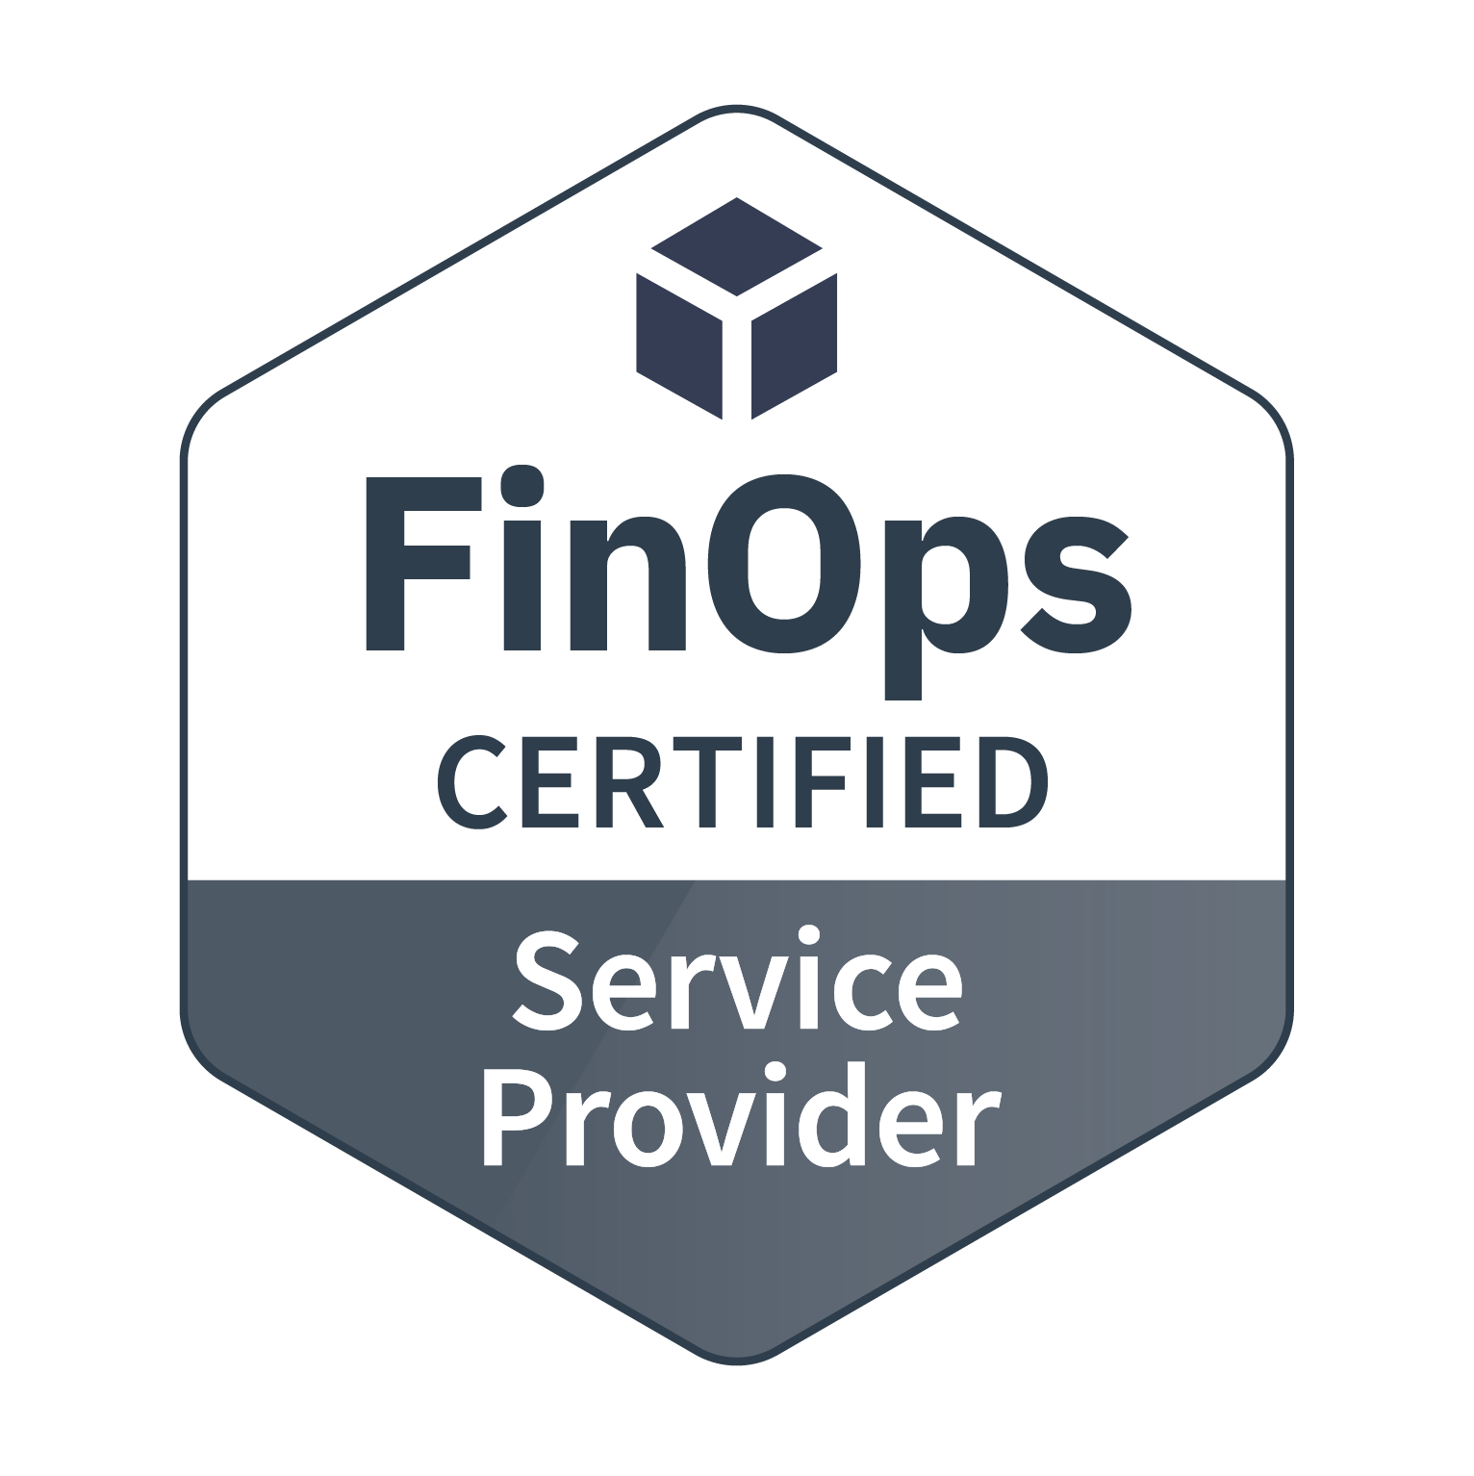
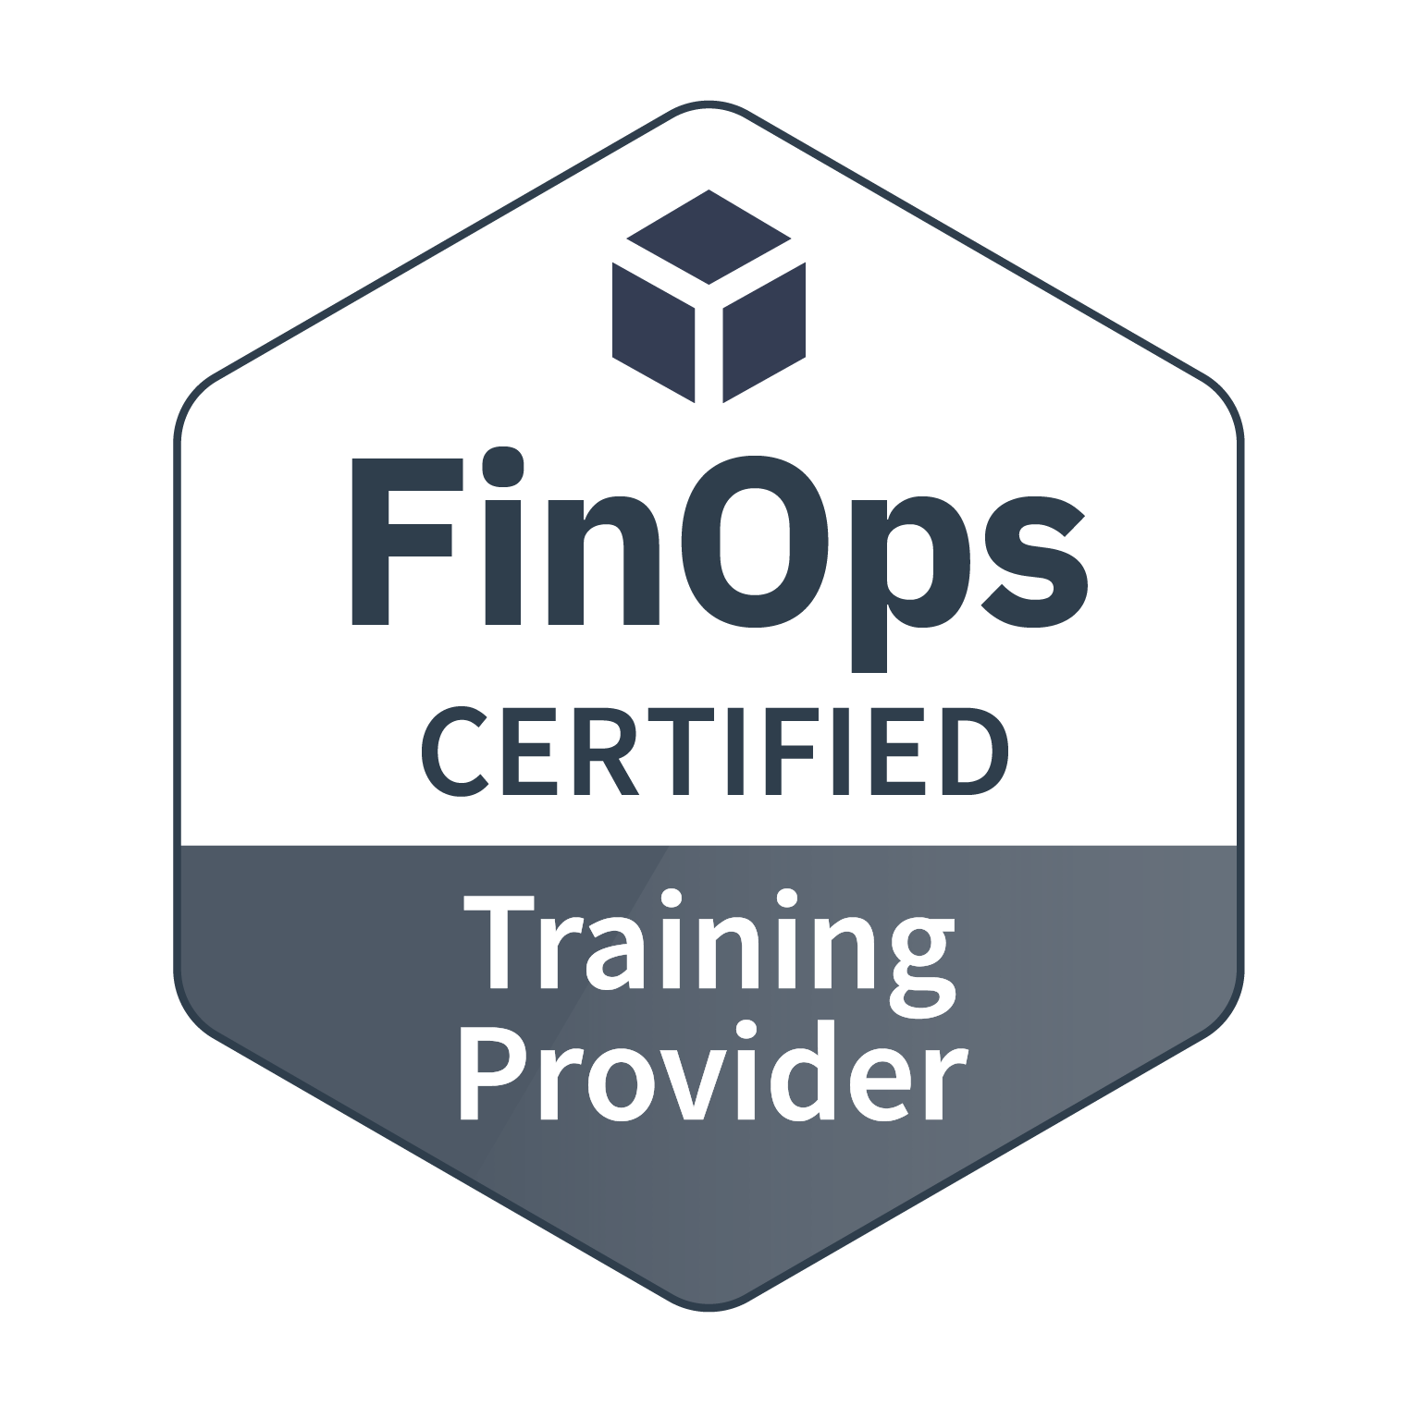
Vendor Certifications
Technology providers that license and deliver a software product to help people successfully adopt cloud financial management practices aligned with the FinOps standards.
Providers that deliver solutions that contain a subset of the functionality found in the Certified Platforms which solve a specific part of a cloud cost management challenge.
FinOps experienced professional service providers that consult with enterprises about cloud financial management and help their clients with best practices.
Vetted training providers who have deep experience in cloud financial management training.
View details and requirements

