Slide 1

License Attribution / Use
This work is licensed under a [Creative Commons Attribution 4.0 International License][cc-by].
Use or Adaption of this work requires attribution to the FinOps Foundation under the ccby4.0 license.
You are free to:
Share — copy and redistribute the material in any medium or format
Adapt — remix, transform, and build upon the material for any purpose, even commercially.
Under the following terms:
Attribution — You must give appropriate credit, provide a link to the license, and indicate if changes were made.
More details can be found at https://www.finops.org/introduction/how-to-use/

Slide 2
Advancing the people who manage the value of cloud
FinOps.org

Slide 3



Cloud is critical to every business but is a fundamentally different consumption model...
Decentralized
Variable
Scalable
Engineers siloed from Finance (and Procurement) are empowered to commit the company to spend
Variable cloud spend replacing data center/fixed cost spend, including numerous ways to optimize rates
Instant access to a variety of resources enables innovation but often results in overprovisioning
Notes:
Cloud is critical to success by bringing
The new cloud economy has us facing some new realities in the IT world:
Traditional procurement silos have broken down, buying is decentralized, and it’s only getting more so
Cloud adoption, once the purview of CTOs and the location of science-fair projects now represents MATERIAL and substantial costs for many companies, and it’s only growing
What you buy in the cloud is variable, it changes month to month, day to day, minute to minute. It’s not predictable, and it’s hard to forecast well using traditional methods. And with over 1M Cloud SKUs out there, it’s only getting more complex.
In a cloud world of vast supply, plentiful options and few constraints on your spending, inefficiency is inevitable. But all businesses must focus on efficiency, and need the information to create it. Further, macroeconomic pressures – elections, Brexit, and the coming economic downturn (eventually there will be one) – require even more ruthless efficiency measures.
Inefficiency becomes a target on IT’s back (very important) in a downturn.
Luckily, there’s also a new operating model for the cloud to help address these realities.

Slide 4
Cloud FinOps is an evolving cloud financial management discipline and cultural practice that:
enables organizations to get maximum business value
FinOps is not shorthand for “Financial Operations”. It is a portmanteau of “Finance” and “(Dev)Ops”, stressing the communications and collaboration between business and engineering teams.
by helping engineering, finance, and business teams
to collaborate on data-driven spending decisions
Use of this work requires attribution to the FinOps Foundation under the ccby4.0 license

Slide 5
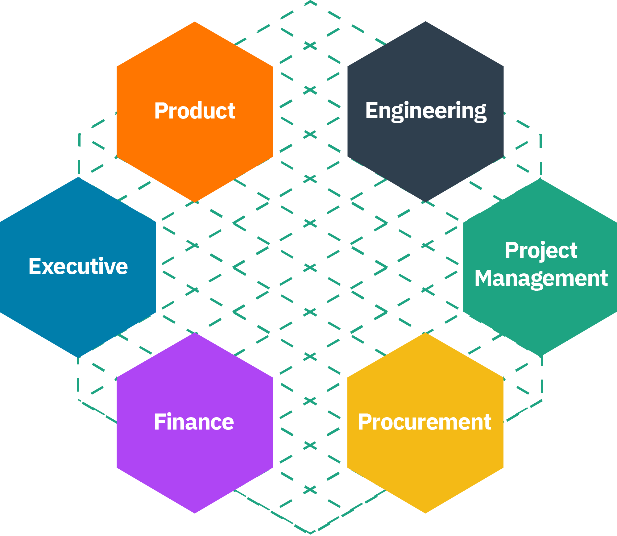

Who does FinOps?
In the same way that everyone is responsible for security with a central team enabling best practices (at scale), many roles do FinOps with help from a central team.
“If I do my job properly I do not need to be in the room when Finance and DevOps teams meet. They are enabled by the work I have done to normalize the cloud bill, allocate and highlight key data points. When FinOps succeeds the business is using the data of FinOps to make better decisions on its own.
Mike Fuller, CTO FinOps Foundation, Former Head of FinOps at Atlassian
Finance
Executives
Procurement
Engineering
Product
Notes:
Before I begin there is one thing that really needs to be kept in mind, FinOps is not done by the FinOps team. Where it makes sense to have a dedicated FinOps team—which we will cover below—that team drives the FinOps activities within an organization. FinOps is a portmanteau of Finance and DevOps to highlight that the goal is for these two teams to work together. I would often say:
““If I do my job properly as a FinOps Practitioner, I do not need to be in the room when Finance and DevOps teams meet. They are enabled by the work I have done to normalize the cloud bill, allocate and highlight key data points. When FinOps succeeds the business is doing FinOps.”
If security if Job 0, then FinOps is Job 0.5.
In the same way that everyone does security with a central team enabling best practices (at scale), everyone does FinOps with help from a central team.

Slide 6
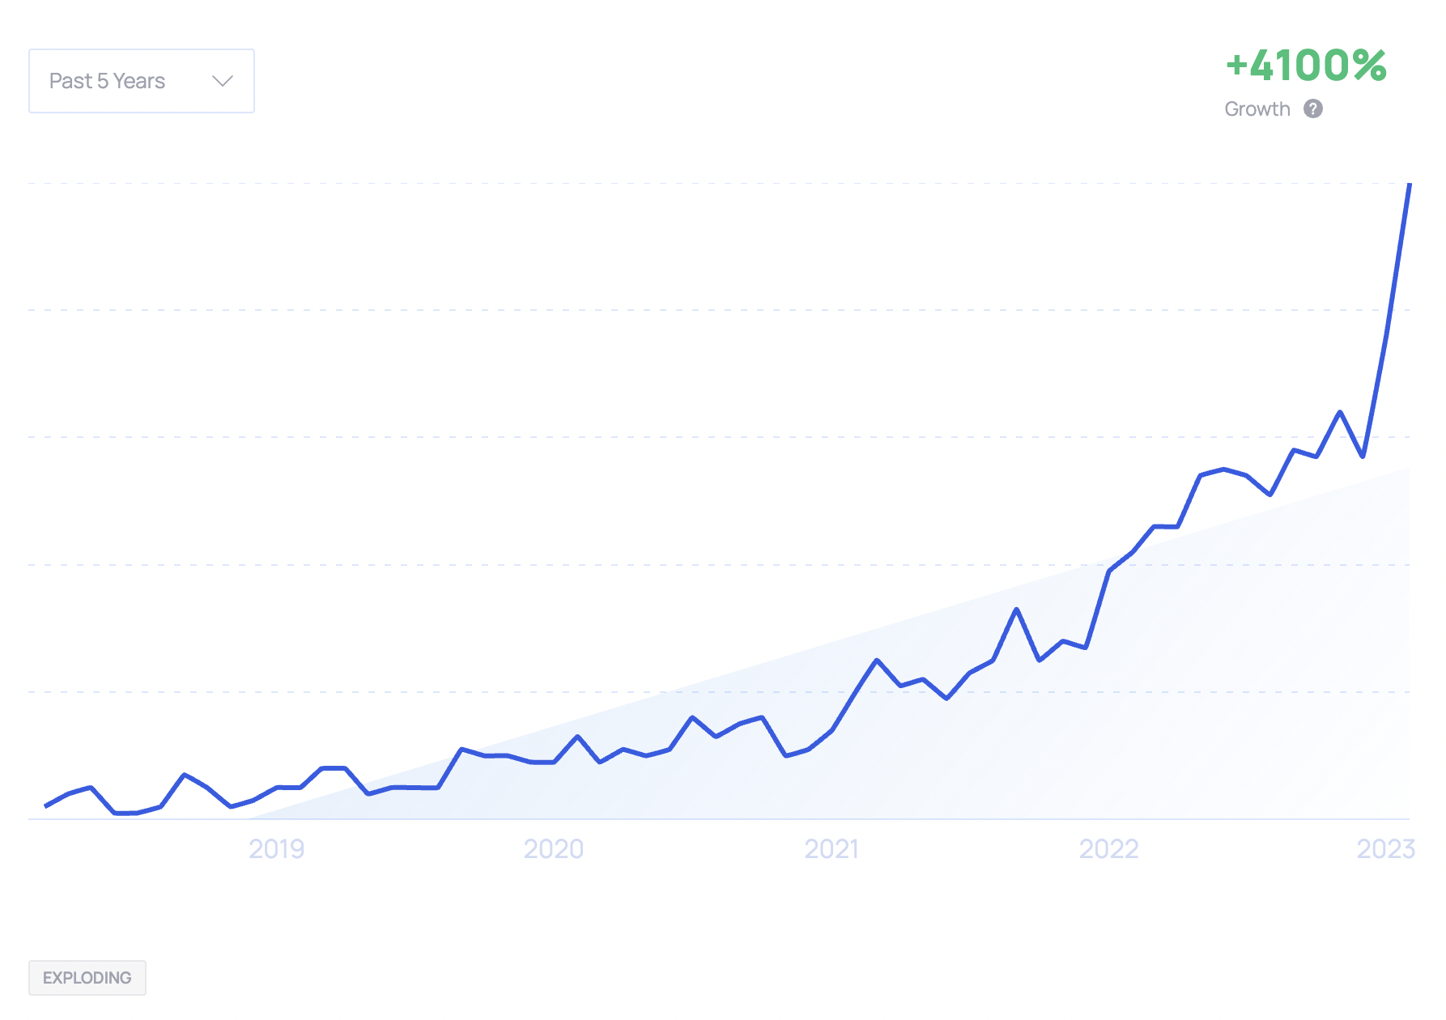
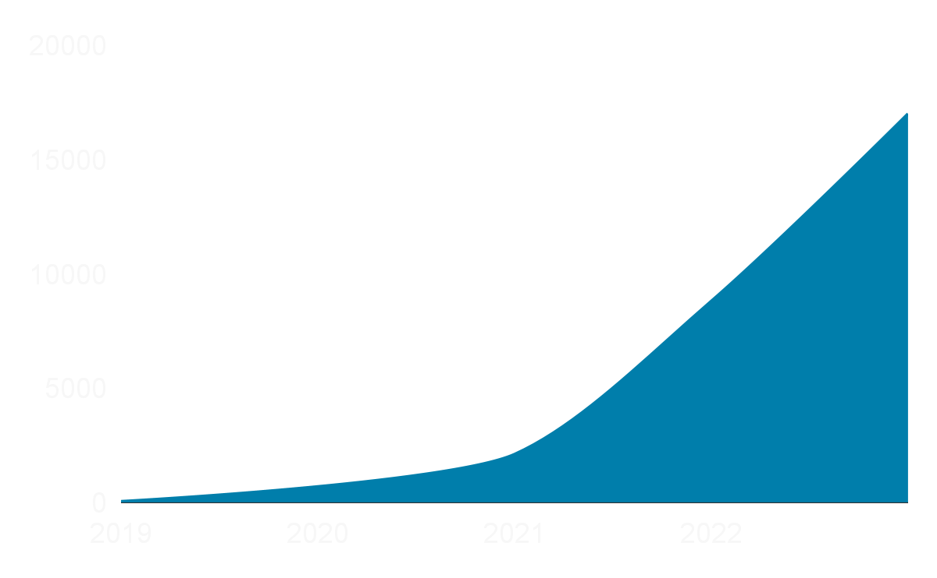
Search Growth
Career Growth
Searches & trending of “FinOps”
People listing “FinOps” as a skill
Notes:
FinOps as a discipline has exploded over the last 5 years, as evidenced by the explosive growth of the search term itself.
When revisiting the first edition of the Cloud FinOps book, we noticed how much it used an us vs. them tone when it came to FinOps teams vs engineering teams. Some of the phrasing indicated that engineers were somehow outside of the work of FinOps and that they didn’t generally care about cost. This is far from the truth in companies who are mature in their cloud—and FinOps—transformation. Unengaged engineers who only do reactive cost optimization merely reflects an immature practice and maturity, where inefficiencies are left to occur and the FinOps process is limited to cleaning up the waste. Instead, mature practices partner with engineers on service design in order to avoid inefficiencies in the way services are deployed on cloud

Slide 7































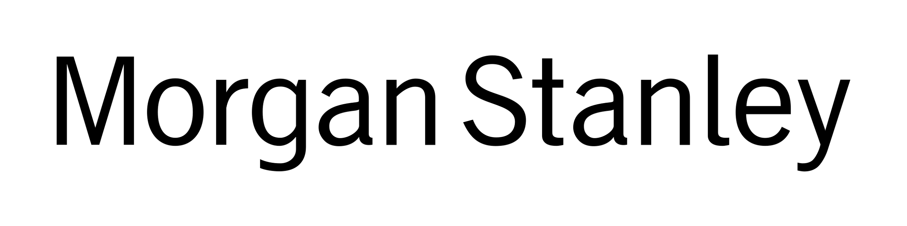




















9 of the Fortune 10 & 44 of the Fortune 50
are represented in the FinOps Foundation
Notes:
To add some context to this growth, here’s a look at which organizations have invested in their FinOps practices.

Slide 8
Team growth comes with cloud spend and complexity
(Figures are stated annual cloud spend, all data from the 2023 State of FinOps)
of those who manage less than $1M do not have a formal FinOps person or team
The responsibility in these situations falls into an existing role, of which
68% lived within Engineering, DevOps or IT
62%
Average team sizes by amount of cloud spend
$1-10M
$10-100M
$100M-500M
$500M-$1B+
2
4
7
10
Notes:
Teams don’t really start until material spend is happening, Who is looking after the spend at the small size - typically it is engineers
When do orgs have a dedicated FinOps team or person
Sizes of dedicated folks in comparison to spend and is also normally a sign of complexity
It is worth pointing out teams can be made up in different ways, ona recent virtual summit we shared how contractors and consultants are in the mix also. Check out the previous recording or the website for those details.

Slide 9
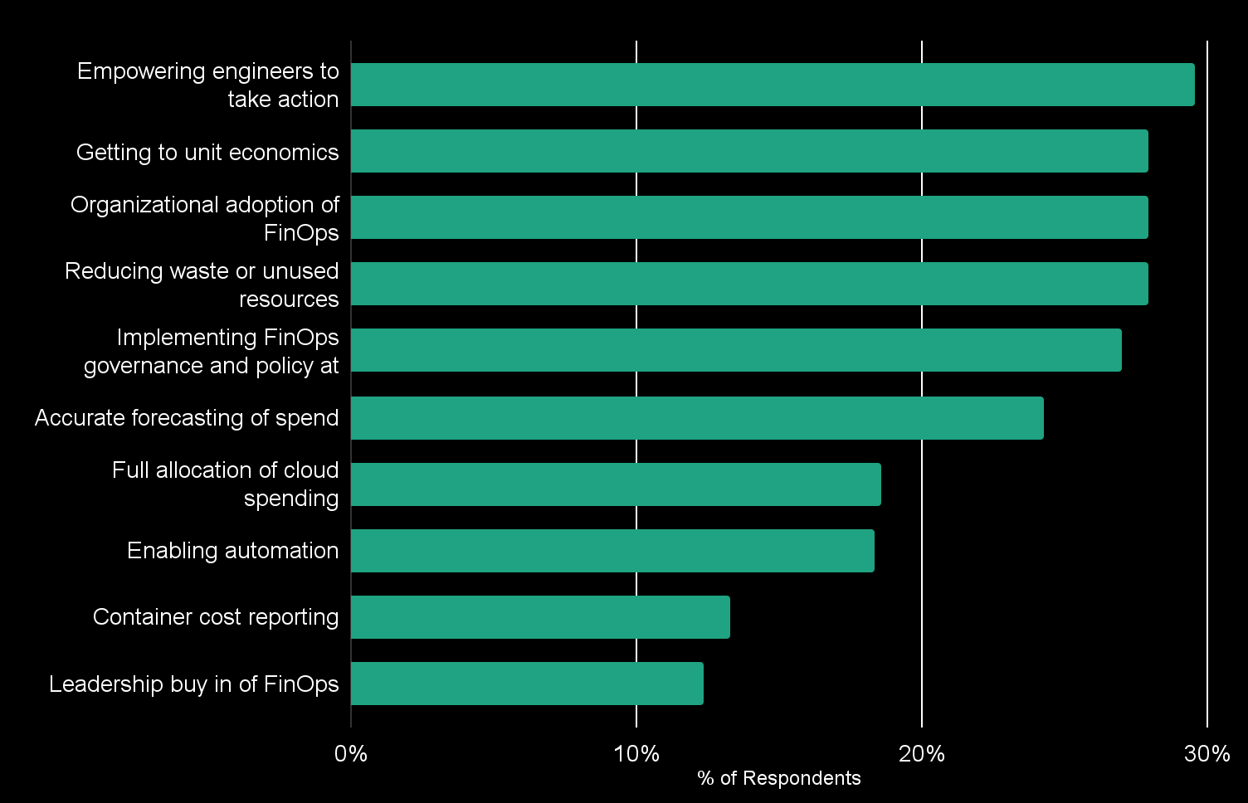
Top Pain Points for FinOps Practitioners
(Arrows represent % directional change vs 2022, multi-select answers)
BY CLOUD SPEND
$100M+
Implementing FinOps governance and policy at scale (38.7%)
$10-100M
Getting to unit economics
& Reducing waste or unused resources (both 33%)
$0-10M
Organizational adoption
of FinOps (36.8%)
• Empowering Engineers to take action stayed stable as top spot • Unit economics new option tied #2 spot with #3/4
• 30% growth Reducing waste came up considerably • 17% drop in forecasting • 15% increase in container cost challenge
Notes:
One of the main areas of the survey are the top challenges which are a lot closer than previously (2022 had a 10% gap from 2-5 in 2022) this year it is less than 1% gap.
Empowering Eng to take action - stayed stable as top spot
Unit economics: new option tied to #2 spot tied with #3/4.
30% growth Reducing waste came up considerably
17% drop in forecasting
15% increase in container cost challenge

Slide 10


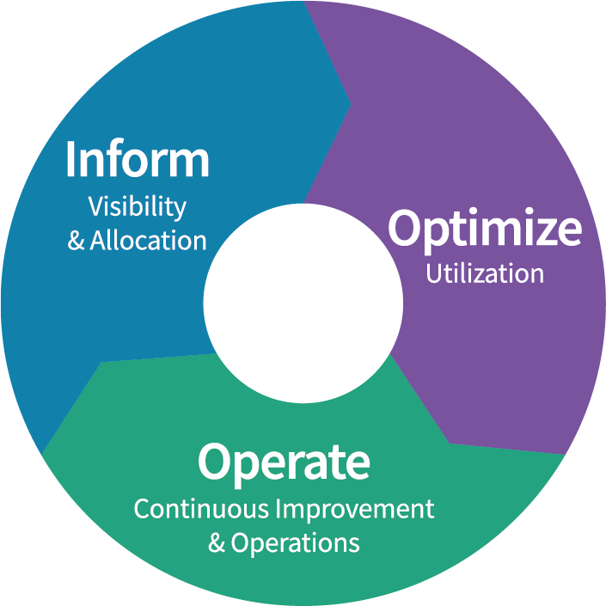





FinOps
Framework
Use of this work requires attribution to the FinOps Foundation under the cc by 4.0 license
Definitions
Maturity
FinOps is an evolving cloud financial management discipline and cultural practice that enables organizations to get maximum business value by helping engineering, finance & business teams to collaborate on data-driven spending decision
Principles
Personas
Crawl
Walk
Run
Phases
Teams need to collaborate
Everyone takes ownership for their cloud usage
A centralized team enables FinOps
Reports should be accessible
and timely
Decisions are driven by business value of cloud
Take advantage of the variable cost model of the cloud
FinOps Practitioner
Engineering/Operations
Rates
& Usage
Business/Product Owner
Finance/Procurement
Executives
Domains & Capabilities
Understanding Cloud Usage
and Cost
Performance Tracking & Benchmarking
Real-Time Decision Making
Cloud Rate Optimization
Cloud Usage Optimization
Organizational Alignment
Notes:
The FinOps Framework describes the
Principles that drive our FinOps practice%s
The Personas that FinOps must support as stakeholders
The best practices and process models that allow us to accomplish this
And the Domains of activity we will have to perform in our FinOps practice
We use a Looping, flywheel lifecycle for FinOps, seeking to
Inform
Identify Optimization targets
Operationalize those changes
In a flywheel approach that starts off slow and takes a “Crawl, Walk, Run” maturity approach to solving the challenges Cloud introduces to an organization.
You May have heard the Framework called the FinOps Capability Model, or the FinOps Function model previously.
Updated beginning in Fall 2021, will continue to be modified as time goes on, but is largely stable as of January 2022.
FinOps practitioners will perform activities in each of these domains as they build a FinOps team and drive the cultural change that FinOps brings into their organizations.

Slide 11



FinOps Foundation Mission
To advance every individual who manages the value of cloud wherever they are.
Create Connections
Inspire
Growth
Empower Best Practices
Objective: Enriching connections
wherever you are
Objective: Advancement for whatever level you are
Objective: The definitive resource for all FinOps practices
Notes:
For those who maybe new or as a reminder on the Foundations mission -
It is - to advance every individual who manages the value of cloud with enriching connections with community, professional advancement in training and education, and defining a clear roadmap for success with resources for all practices.
This community helps create and support skilled practitioners to fill the ever expanding need of the industry.

Slide 12
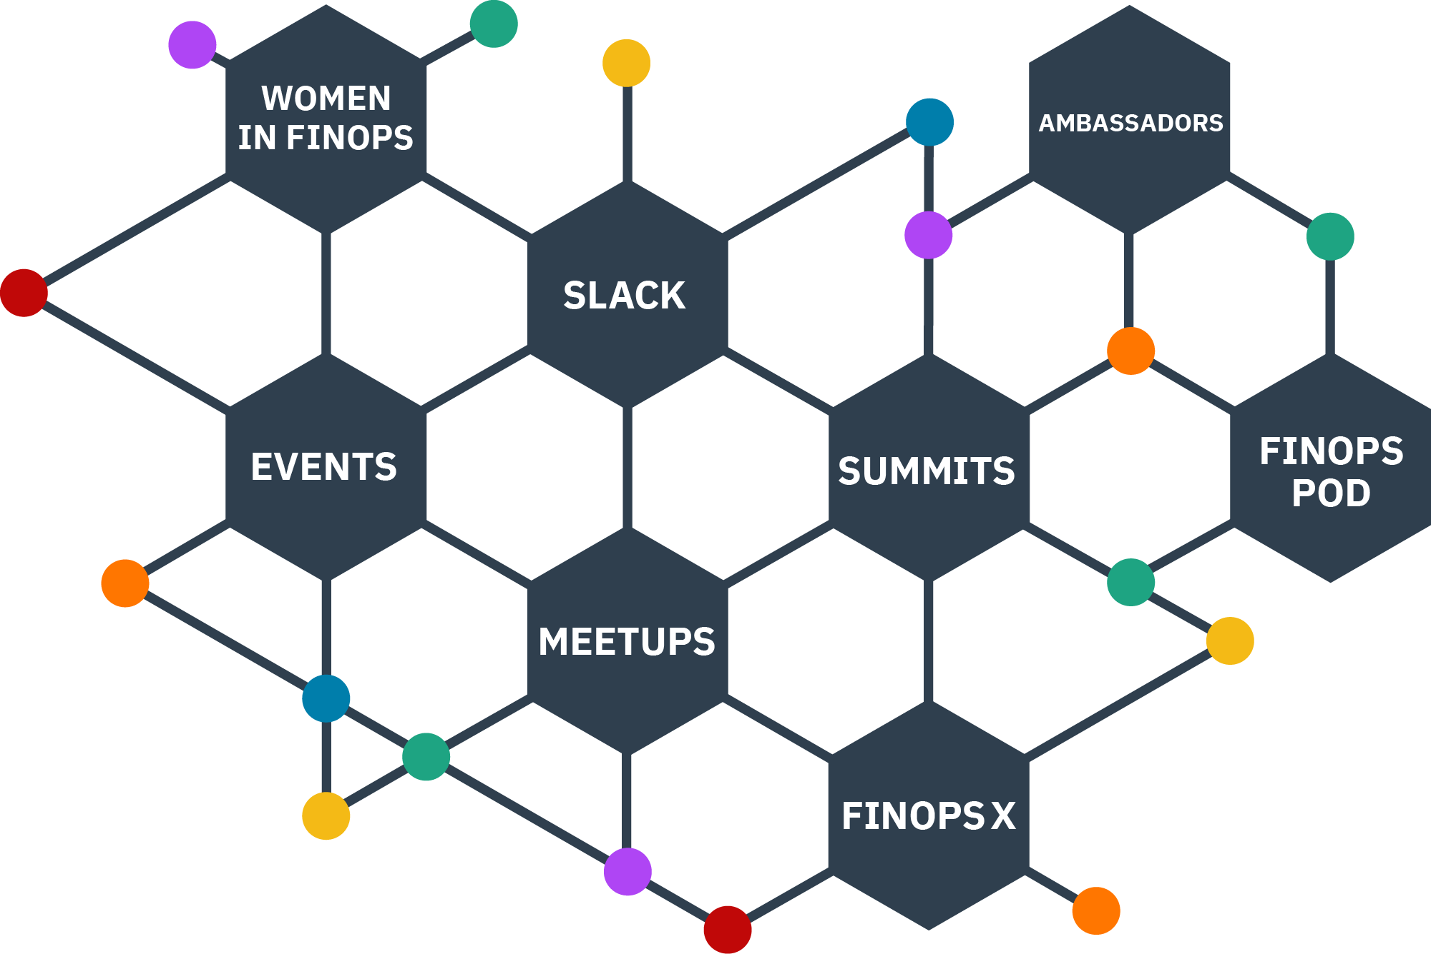
FinOps Community
Join our community of members to enrich your connections and
knowledge through events, meetups, virtual summits, Working Group contributions, Slack discussions, and other activities all over the world.
Can’t make our virtual FinOps events? Catch up with a variety of recordings on our YouTube Channel.

Slide 13
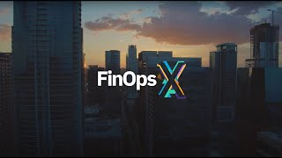
Join practitioners at FinOps X
Another way we celebrate and support our growing community and help them network with other practitioners is by encouraging everyone to join us annually at our conference, FinOps X.
Listen to stories from our experts, meet other practitioners, and know that you aren’t alone on your FinOps journey.

Slide 14
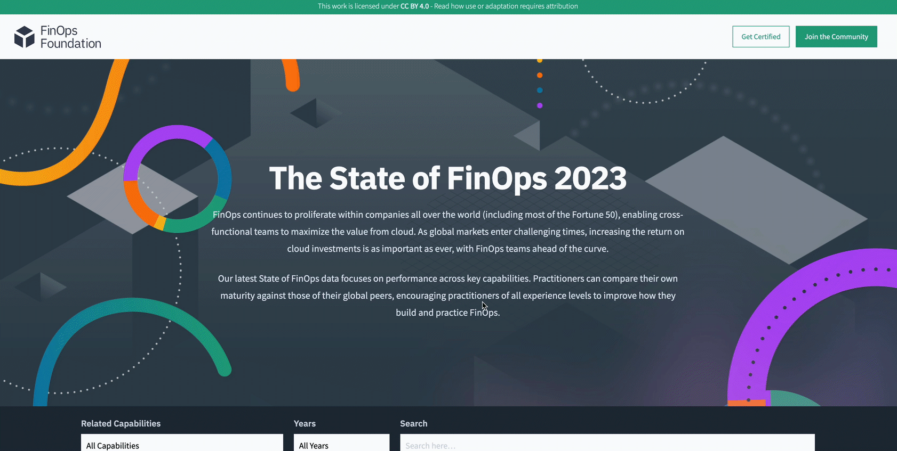
Stay updated with the State of FinOps
Get the latest industry benchmarking and FinOps trends from the State of FinOps.
Dive deep into a variety of charts to better understand how practitioners are adopting and mastering FinOps.

Slide 15
Addendum

Slide 16
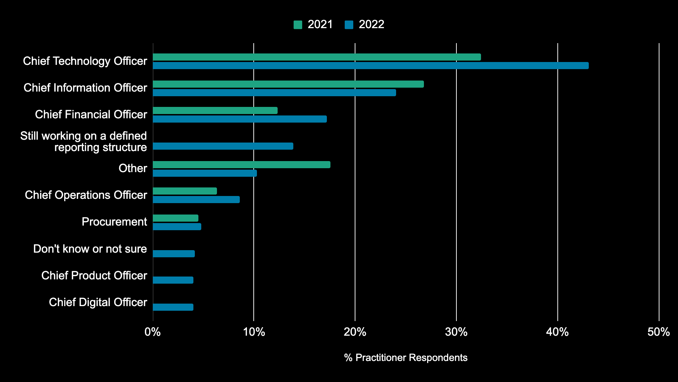
Where does FinOps/cloud financial management report in your organization?
(multi-select question; answers total more than 100%)
Use of this work requires attribution to the FinOps Foundation under the ccby4.0 license

Slide 17
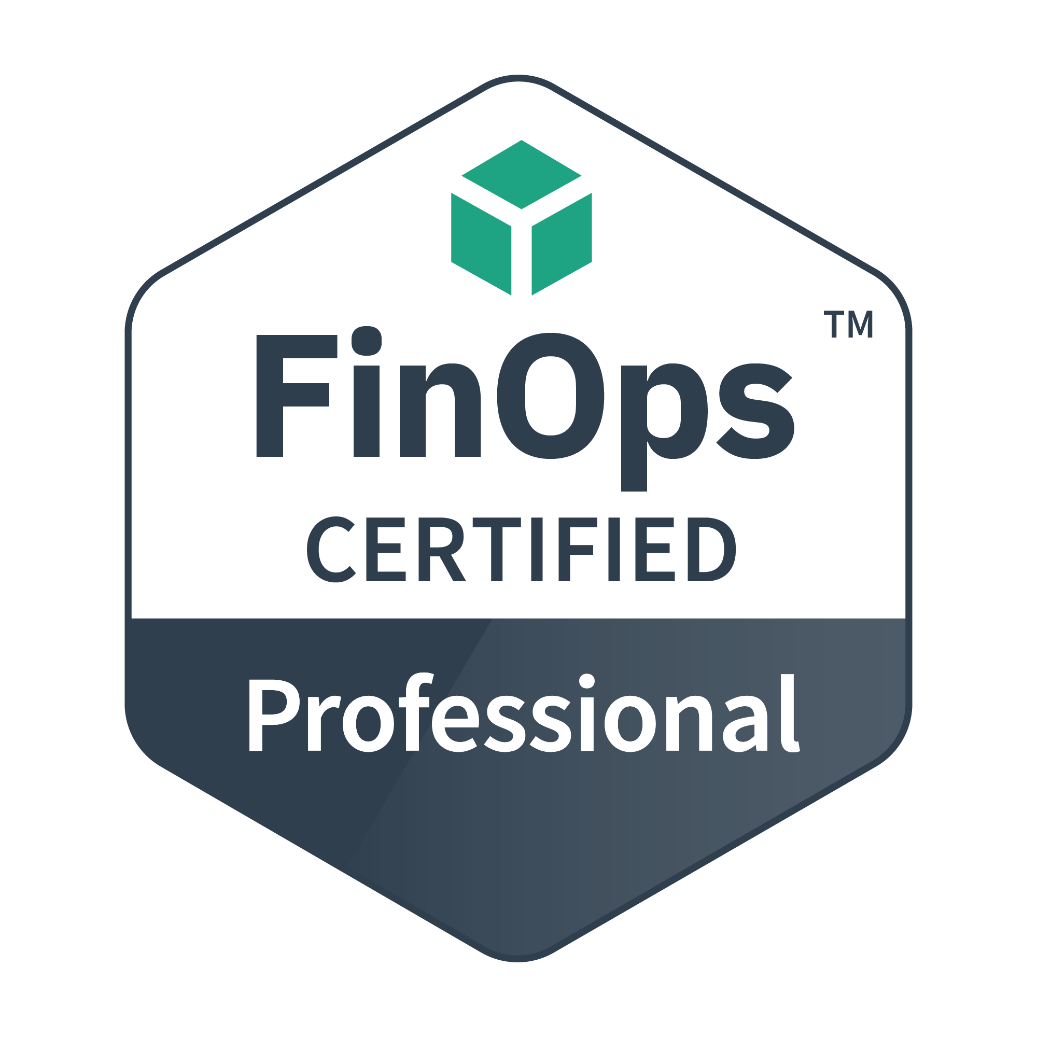
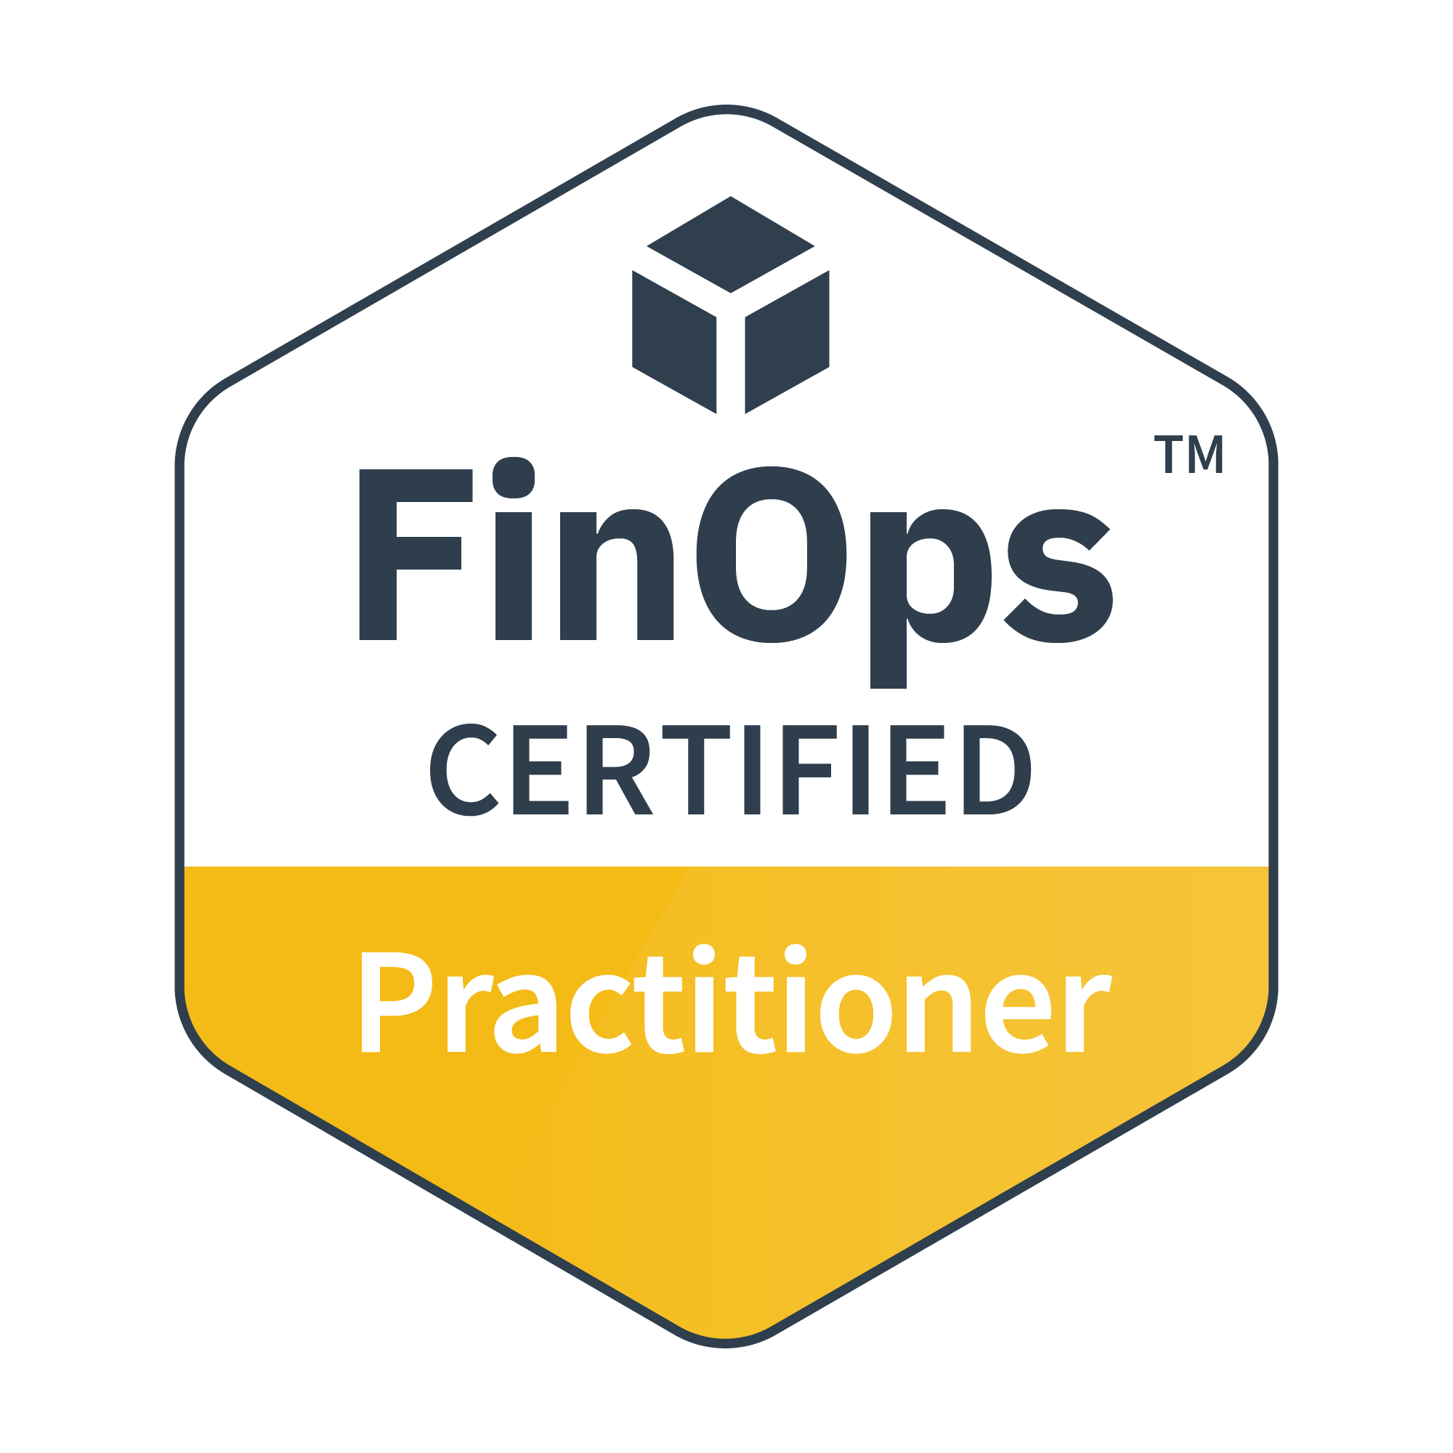
Training and Certification
Certification Track for FinOps practitioners and consultants
FinOps Certified Practitioner
FinOps Certified Professional
Persona-based Training for stakeholders working with FinOps teams
Individual courses for Engineers, Finance, Executives, Procurement, and Product
Go to learn.finops.org FinOps.org/certification
Join the ranks of 5000+ FinOps Certified Practitioners
Notes:
Our funding comes from two primary sources: 1) is Training/Certification.
There’s the FOCP now and also FOFE. FOFA is in development as well as persona based trainings for Finance/Execs/etc.

Slide 18
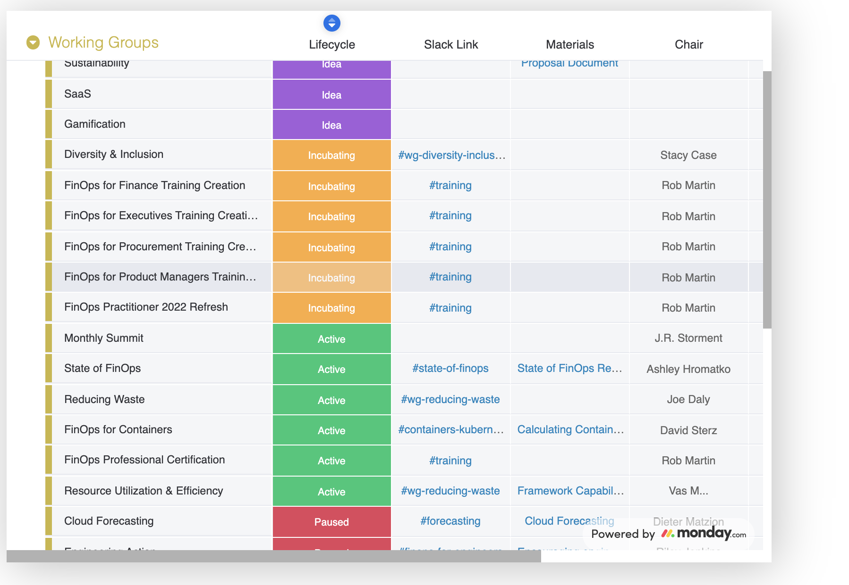
Contribute to Working Groups
Practitioner Working Groups (WG) create best practices and standards, supported by vendor members.
Special Interest Groups (SIG) create community and benchmarking.
These feed into the FinOps Framework and output Projects.
See Current Groups

Slide 19
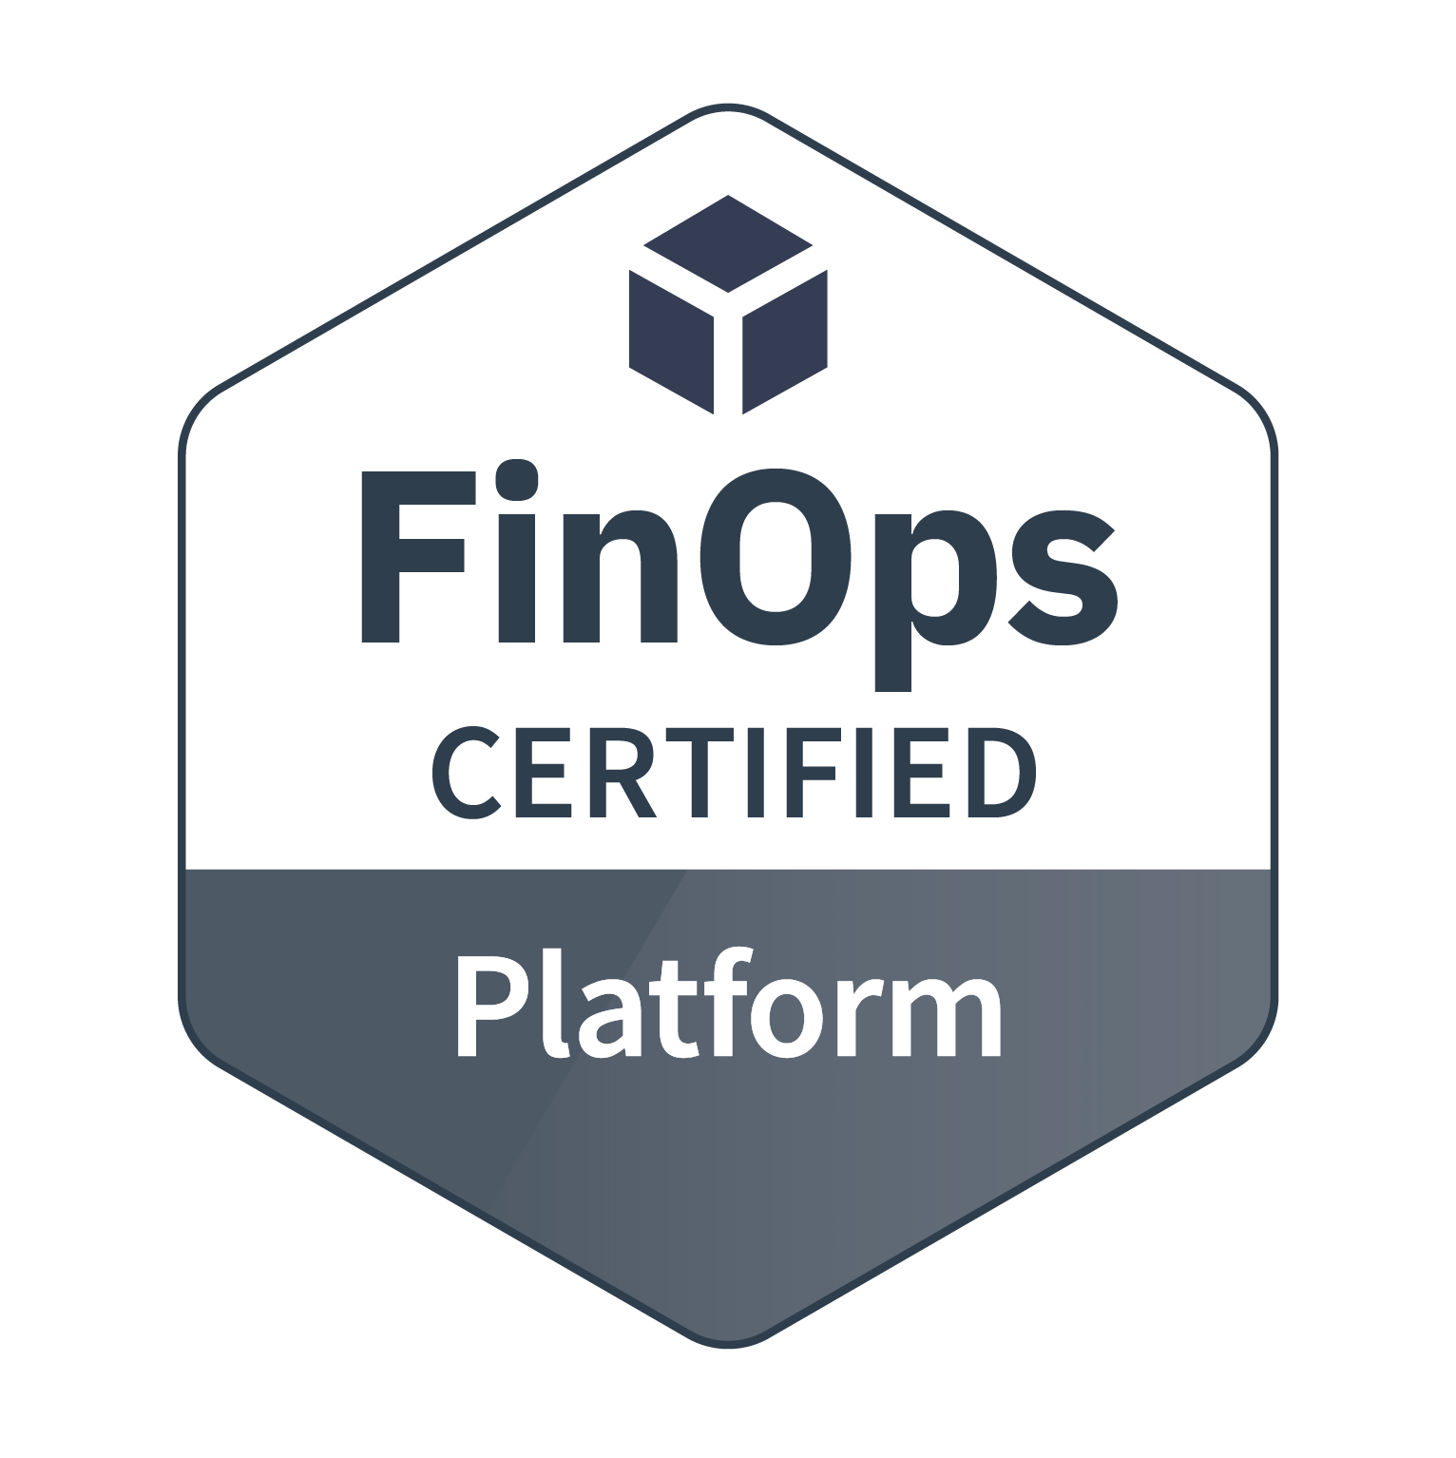
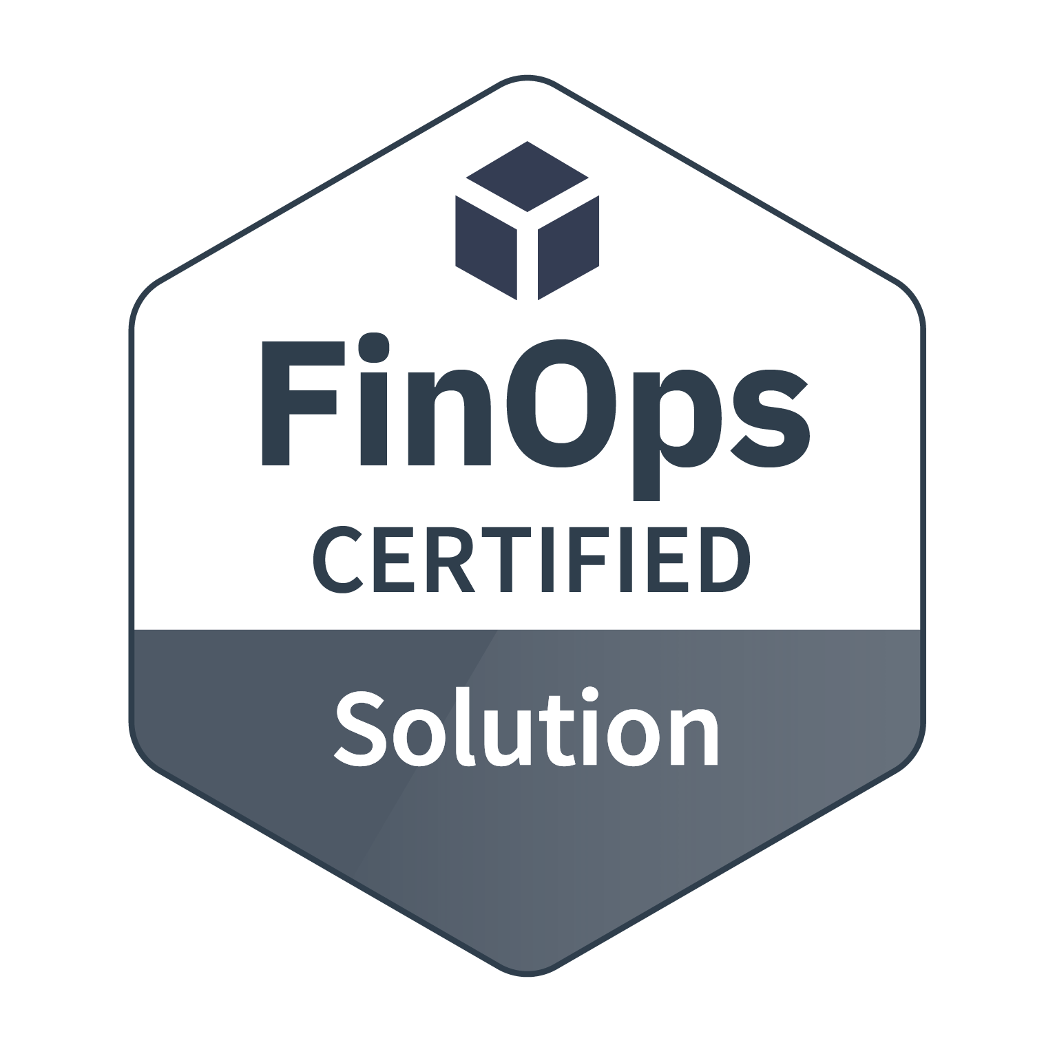
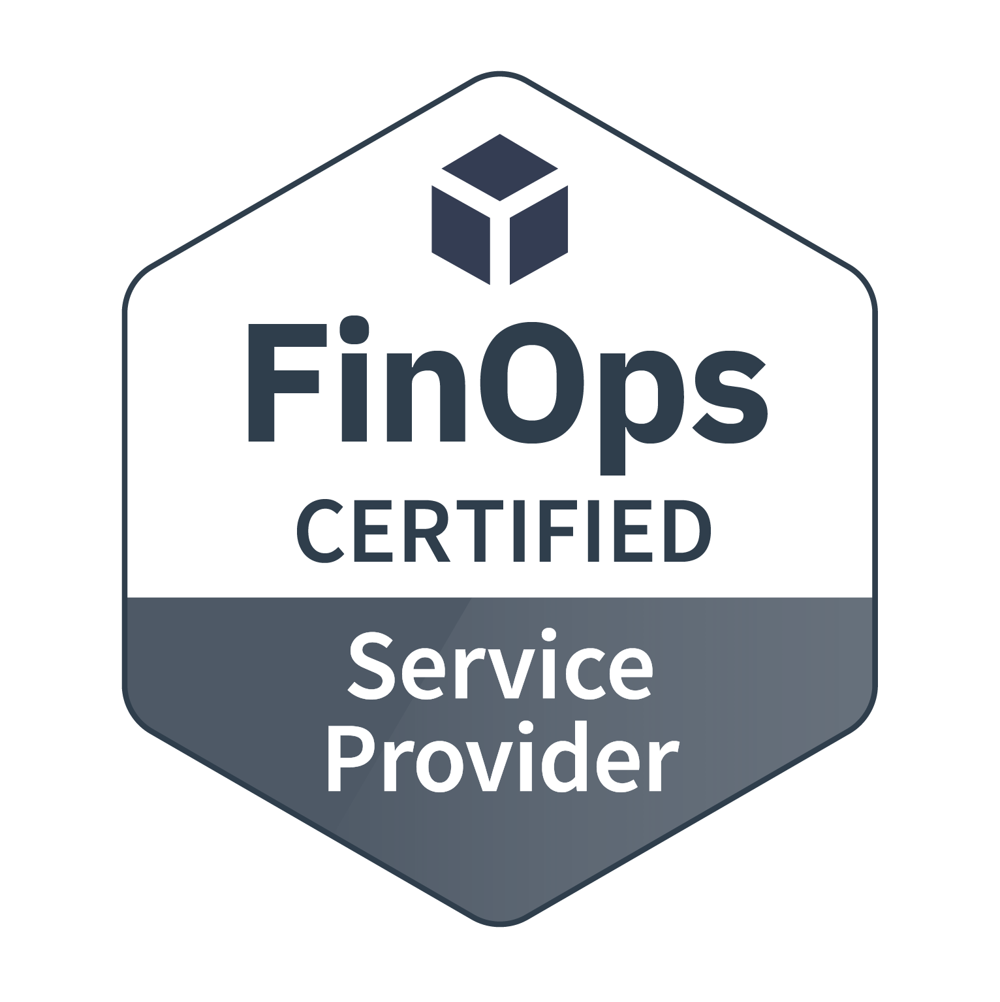
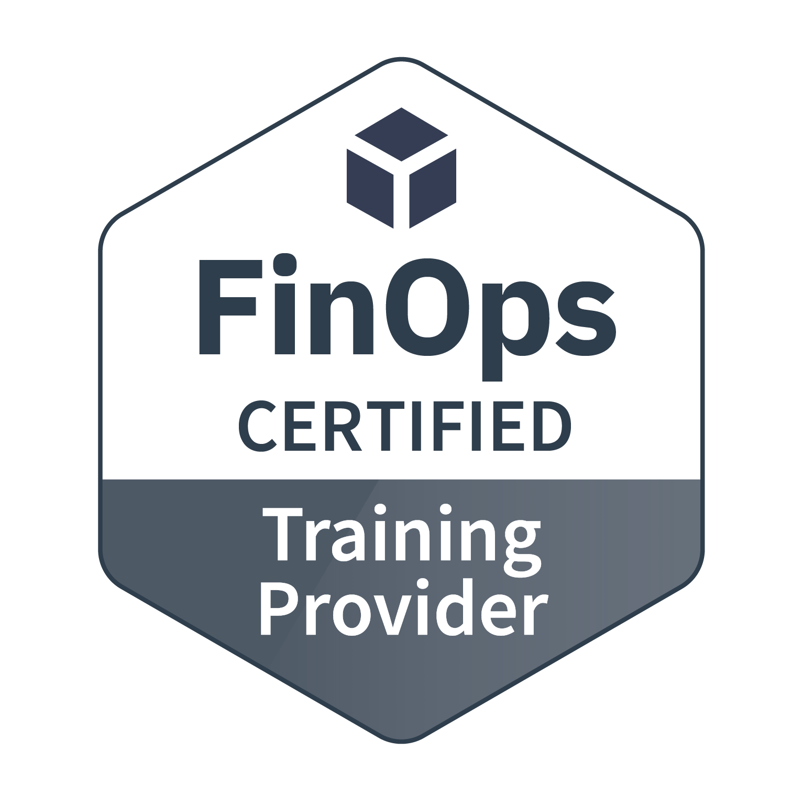
Vendor Certifications
Technology providers that license and deliver a software product to help people successfully adopt cloud financial management practices aligned with the FinOps standards.
Providers that deliver solutions that contain a subset of the functionality found in the Certified Platforms which solve a specific part of a cloud cost management challenge.
FinOps experienced professional service providers that consult with enterprises about cloud financial management and help their clients with best practices.
Vetted training providers who have deep experience in cloud financial management training.
View details and requirements

